Slide 1
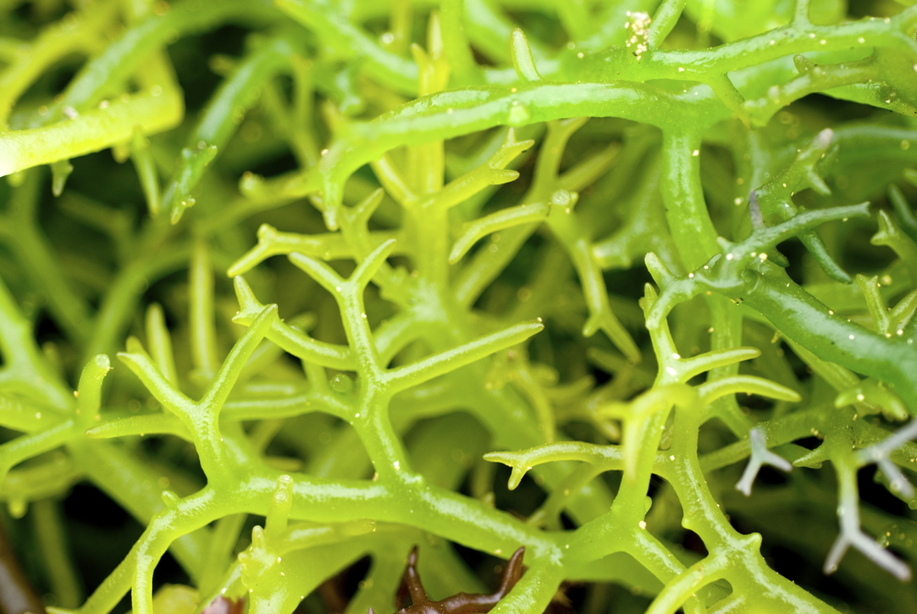
Aquatic Plants – Green Algae
www.onacd.ca

Slide 2
Green Algae
There are approximately 6000 species of green algae. Many live their lives as single cells while others form colonies or long filaments. Species of green algae can be aquatic (freshwater or marine) or terrestrial. Some green algae are even capable of forming symbiotic relationships with fungi to form lichens.
Chlamydomonas
Spirogyra
Ulva

Slide 3
Characteristics of Green Algae
Most contain chloroplasts and nuclei (chlorophylls a & b give them the green color)
Have mitochondria with flat cristae
Some have flagella for movement
All have cell walls that contain cellulose
Some species can reproduce asexually by fission, fragmentation or zoospores (motile spores)
Most species can reproduce sexually using a method called “alternation of generations” where they go through 2 different life stages

Slide 4
Alternation of Generations What is it?
A life cycle in which there are two distinct life stages that occur alternately for a species
Stage 1 (the sporophyte generation)
Diploid (2N – each cell has two sets of chromosomes)
Produces haploid spores by meiosis and is thus called a sporophyte
Stage 2 (the gametophyte generation)
Haploid (1N – each cell has one set of chromosomes)
Produces gametes (sex cells) by mitosis and is thus called the gametophyte
Gametes then fuse to form a diploid zygote which grows into a new sporophyte

Slide 6
Let’s take a closer look at some different types of examples of members of the Green Algae

Slide 7
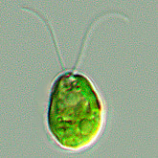
Chlamydomonas
Characteristics
Unicellular
Motile, 2 equal flagella
Occur in stagnant water and damp soil, fresh water and salt water; even in snow!
Have a nucleus inside their chloroplast
Possess two small vacuoles which function to remove waste
Have a light sensitive, red pigment spot which allows the cells to swim towards light (this is called positive phototropism)

Slide 8
Chlamydomonas Life Cycle
Take a good look at the diagram below of the life cycle of Chamydomonas which is an example of an alternation of generations. Try to identify the diploid (2N) and the haploid (1N) stages of its life.
Diploid (2N)

Slide 9
Spirogyra
Algal cells are joined end to end to form filaments (multicellular)
Mostly freshwater
Generally free floating
Reproduces asexually by fragmentation and sexually by conjugation
Does not form gametes, therefore does not go through alternation of generations
Above: Spirogyra filaments undergoing conjugation
What is conjugation?
It is merely the transfer or exchange of genetic information from a donor cell to a recipient

Slide 10
Ulva (sea lettuce)
Multicellular green algae (looks like a plant)
Lives in marine and brackish water
Has flat, blade like leaves called a thallus which is made up of two layers of cells
Undergoes alternation of generations to reproduce
Gametes are free-swimming and a zygote is formed in the water

Slide 11
Ulva Life Cycle
MITOSIS
Can you label in the diagram where mitosis would be taking place?

Slide 12
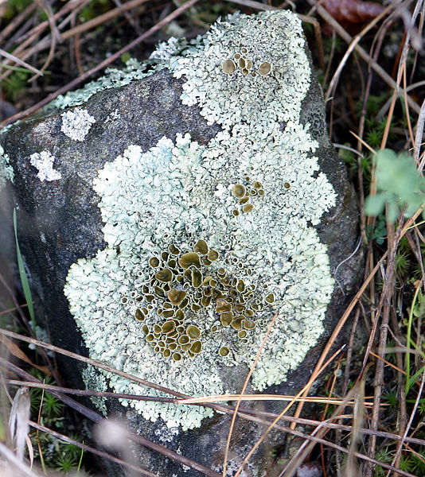
Lichens
Can be formed by a symbiotic relationship between a green algae and a fungus
The fungus provides the algae with water and minerals that it absorbs from whatever it is growing on, and also protects the algae by retaining water and serving as a larger capture area for minerals and nutrients

Slide 13
The algal cells use minerals and water to make food (by photosynthesis!) for the fungus and itself
The fungus surrounds the algal cells and one cannot live without the other
Above: Cross-section through the lichen Pseudevernia furfuracea with plainly visible layer of green algae under the surface

Slide 14
5 Really Bad Algae Jokes…..
Why did the algae and the fungus get married?
They took a lichen to each other.
Why do many algae couples drift apart?
They prefer planktonic relationships.
Why couldn't the algae keep a girlfriend?
He wasn't a fungi.
Why did the algae get pulled over on his way to the pond?
He was chloro-plastered.
Why did the algae fail math?
He divided when multiplying.

Slide 15
Algae
Naming
Rhodophyta = Red Algae
Chlorophyta = Green Algae
Phaeophyta = Brown Algae

Slide 16
Characteristics of Algae
They are built up of multiple cells
They have organelles
They use the photosynthesis reaction to obtain energy in the form of sugar (glucose)
Some are motile and contain flagella

Slide 17
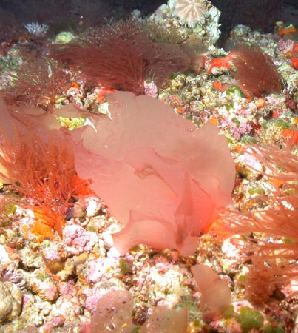
Red Algae
Found mostly in salt water
Color pigments
Chlorophyll “a” and sometimes “d”
Carotenes
Soluble phycobilins
Red pigment phycoerythrin
Blue pigment phycocyanin

Slide 18
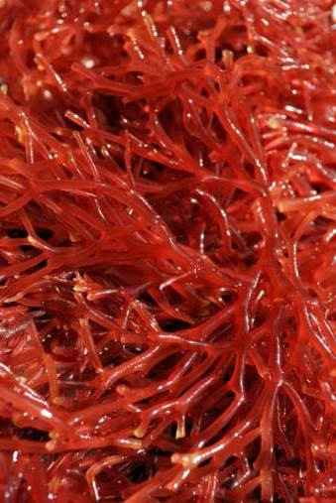
Red Algae
They grow at depths of 175 meters (574.14 feet i.e. 109 times my height)
They are red as only blue light can make it to these depths. The color of light something absorbs is different than the color we perceive.
White reflects all colors and Black absorbs all colors.

Slide 19
Green Algae
Color pigments
Both chlorophyll “a” and “b”
“b” makes it more like a terrestrial plant and therefore is most successful in using photosynthesis.
Habitats
Most commonly in freshwater
They are also found in salt water and other moist environments
Terrestrial

Slide 20
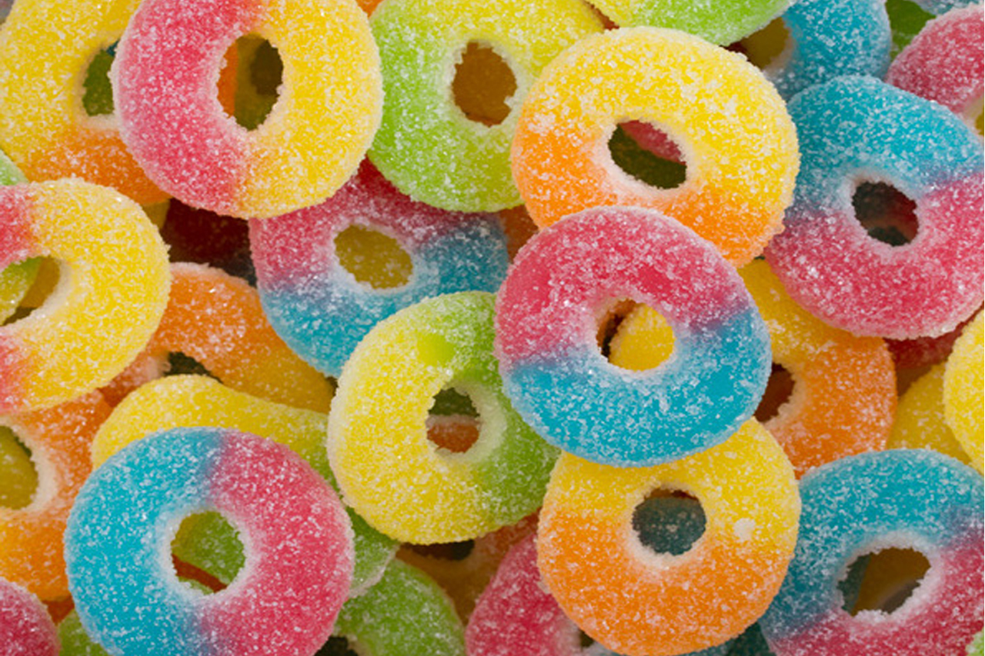
Brown Algae
They are the largest algae in terms of size.
Color pigments
Chlorophyll “a” and sometimes “c”
Fucoxanthin
Algin, which is produced by brown algae, has many functions in society
Puddings, pie and cake fillings
Candy
Toothpaste
Hand lotion

Slide 21
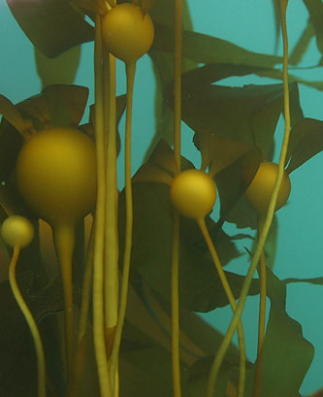
Brown Algae
Larger forms contain airbladders used for floatation
They can grow up to 100 m long.
An obvious example from BC is bull kelp
When scuba diving this kelp is awesome to observe at depth, but problematic to swim through as it can get tangled on your scuba tank.

