Slide 1
Broken Line Graphs

Slide 2
Broken Line Graph
A graph that uses points joined by line segments to display data
The data on the axes tells you the meaning of the graph
The independent variable is located on the horizontal axis (x-axis)
The dependent variable is located on the vertical axis (y-axis)

Slide 3
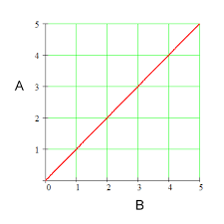
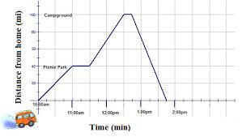
Broken Line Graphs
They can be used to assess data change over time
This is beneficial if there is a change in the trend over time as a linear line graph will not work to assess changes in trends over time

Slide 4
Trends and Estimating Values
It is possible to just use the points on the graph but sometimes it is necessary to look at other locations on the graph
To find these values we use interpolation and extrapolation

Slide 5
Interpolation and Extrapolation
Interpolation: to estimate a value between two known values
Extrapolation: to estimate a value beyond a known range of values
This can only be done if there is a regular pattern in the graph.

Slide 6
Working with misleading graphs
When considering a graph you need to look at the scale and size for this influences how the data on a graph is interpreted
When plotting a graph we can change the scale and size to influence how others interpret our data
This is done by some government agencies and marketing companies to make individuals believe something specific .
For example the trend of a certain item may appear more valuable and therefore influence us to buy this item.

