Slide 1
BC Science Connections 10
Unit 3: Energy is conserved and its transformation affects living things and the environment.

Slide 2
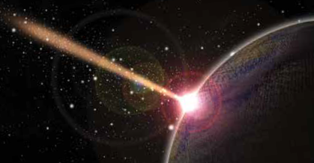
Topic 3.2: How is energy transformed?
Energy is transformed
In chemical reactions.
In nuclear reactions.
When light energy interacts with matter.

Slide 3
Concept 1: Energy is transformed in chemical reactions. (pages 222 to 227)
The amount of energy transformed depends on the chemical bonds in the compounds of the chemical reactants.
In an exothermic reaction, reactants have higher chemical potential energy than the products (energy is released).
In an endothermic reaction, reactants have lower chemical potential energy than the products (energy is absorbed).

Slide 4
Exothermic Reaction

Slide 5
Endothermic Reaction

Slide 6
Chemical Reactions in Animals and Plants (page 224)
All plants and animals carry out cellular respiration to produce energy in the form of ATP (adenosine triphosphate) for life processes.
C₆H₁₂O₆ + 6O₂ → 6CO₂ + 6H₂O + energy
glucose + oxygen → carbon dioxide + water + energy

Slide 7
Chemical Reactions in Animals and Plants (page 225)
Plants and algae capture the Sun’s energy and combine carbon dioxide and water to produce glucose (sugar) and oxygen.
This is the process of photosynthesis.
6CO₂ + 6H₂O + energy → C₆H₁₂O₆ + 6O₂
Photosynthesis occurs in the chloroplasts.

Slide 8
Energy Transformation and Fuels (pages 226-227)
Fossil fuels contain large amounts of chemical potential energy.
When fossil fuels are burned through combustion, energy is released along with carbon dioxide.
Fossil fuels also contain contaminants such as sulfur and nitrogen that pollute the environment.
Fuel cells transform chemical energy into electrical energy and emit fewer pollutants.

Slide 9
Discussion Questions page 227
Where is chemical potential energy in molecules stored?
How is chemical potential energy transformed by living things?

Slide 10
Concept 2: Energy is transformed in nuclear reactions (page 228-232).
Energy is transformed in nuclear reactions when atoms are changed into atoms of different elements.
Isotopes: two or more forms of the same element with the same number of protons, but different number of neutrons

Slide 11
Radioisotopes: unstable isotopes that emit radiation by giving off energy in the form of electromagnetic waves
Nuclear decay: the change of an atom due to the emission of particles or radiation

Slide 12
Types of Nuclear Reactions (page 228-229)
Alpha decay: a nuclear reaction that emits alpha particles or helium nuclei
The new nucleus has two fewer protons and two fewer neutrons.

Slide 13
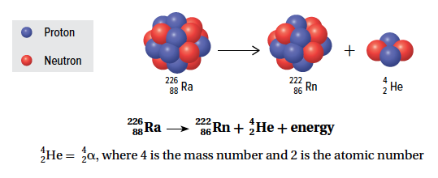
Types of Nuclear Reactions (page 229)
Figure 3.22: Alpha decay of radium-226

Slide 14
Types of Nuclear Reactions (page 229)
Beta decay: a nuclear reaction that emits beta particles or fast-moving electrons
The new nucleus has one less neutron and one more proton.
If the number of protons changes so does the element.

Slide 15
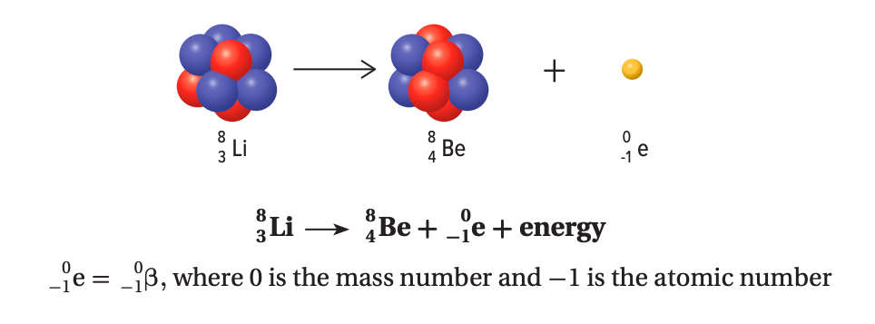
Types of Nuclear Reactions **** FIGURE WRONG IN HANDOUT PROVIDED (page 229)
Figure 3.23: Beta decay of lithium-8

Slide 16
Types of Nuclear Reactions (page 229)
Gamma decay: a nuclear reaction that emits gamma rays or high-energy photons
The unstable isotope that is undergoing the decay has a “*” to represent an excited state.

Slide 17
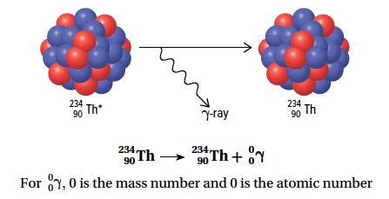
Types of Nuclear Reactions (page 229)
Figure 3.24: Gamma decay of thorium-234

Slide 18
Types of Nuclear Reactions (page 230)
Nuclear fission: a process in which a heavier nucleus is split into smaller, lighter nuclei with the release of energy
It occurs in nuclear reactors.
A single fission reaction usually results in a chain reaction of many further reactions.
Fission means to split into smaller pieces

Slide 19
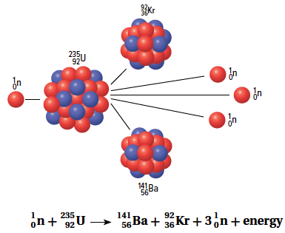
Figure 3.25: When a uranium-235 nucleus absorbs a neutron, it undergoes fission to produce a krypton-92 nucleus, a barium-141 nucleus, and three free neutrons. The krypton and barium isotopes are radioactive.

Slide 20
Types of Nuclear Reactions (page 232)
Nuclear fusion: a process in which two very small nuclei combine, or fuse, to form a slightly larger nucleus
It requires high temperatures.
It occurs in the Sun and other stars.
It does not produce radioactive materials.
Fusion means to join together

Slide 21
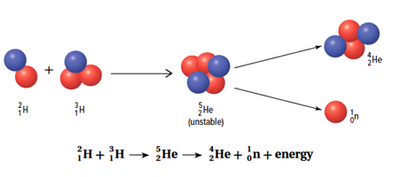
Types of Nuclear Reactions (page 232)
Figure 3.29: Many small nuclei undergo fusion to form a larger nucleus. This is the most common reaction in the Sun.

Slide 22
Discussion Questions page 232
Compare chemical reactions and nuclear reactions in terms of how much energy they transform.
a) What is a radioactive isotope?
b) How do these isotopes get rid of their extra energy?
3. How is alpha decay different from beta decay?

Slide 23
Discussion Questions (page 232)
4. Why does gamma decay occur?
How are nuclear fission and fusion similar? How do they differ?
At a glance, it appears like the law of conservation of energy does not apply to nuclear reactions. Explain why it does.

Slide 24
Concept 3: Energy is transformed when light energy interacts with matter (page 234-235).
Chlorophyll, the green pigment in plants, absorbs light.
Absorption: a process in which energy is taken up by matter without being reflected or transmitted

Slide 25
Photovoltaic Cells (page 234)
Photovoltaic cells transform light energy into electrical energy.
Aka solar cells

Slide 26
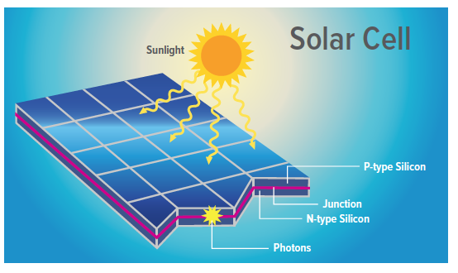
Photovoltaic Cells (page 234)
Figure 3.31: Two types of silicon come into contact in a photovoltaic cell. Some electrons in the N-type jump into holes in the P-type. A separation of charge then attracts the other electrons. When these electrons absorb light energy, they are free to move across the cell, and a current flows through conductors into a circuit.

Slide 27
Vision (page 235)
The rods and cones in the retina of the eye absorb light energy.
An electrical signal is sent to the brain by nerve cells and an image is formed.

Slide 28
Discussion Questions (page 235)
What role do electrons play in transforming light energy?
Compare human vision to a photovoltaic cell in terms of energy transformation.

Slide 29
Topic 3.2 Summary: How is energy transformed?
Energy is transformed in chemical reactions.
Energy is transformed in nuclear reactions.
Energy is transformed when light energy interacts with matter.

