Slide 1
BC Science Connections 10
Unit 3: Energy is conserved and its transformation affects living things and the environment.

Slide 2
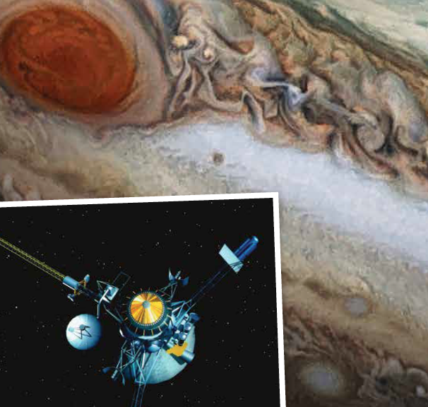
Topic 3.3: How does energy transformation affect global systems?
Earth is a system in which energy is transformed.
Earth’s atmosphere is heated by the transformation and transfer of solar energy and thermal energy.
Energy transfer and energy transformation moderate Earth’s temperature.
Energy transformation and transfer can harm aquatic and terrestrial ecosystems.

Slide 3
Concept 1: Earth is a system in which energy is transformed.
Winds, weather, tides, currents, volcanic activity, and mountain formation on Earth are all due to energy transformations.
Solar energy, gravitational potential energy, and nuclear energy all play important roles in Earth’s system.

Slide 4
Solar Energy
Solar energy has the greatest impact on Earth.
Its transformations drive water movement through the atmosphere and the hydrosphere.
p. 245 Solar energy

Slide 5
Hydrosphere
A hydrosphere is the total amount of water on a planet.
The hydrosphere includes water that is on the surface of the planet, underground, and in the air.
A planet's hydrosphere can be liquid, vapor, or ice.
On Earth, liquid water exists on the surface in the form of oceans, lakes and rivers.
https://www.nationalgeographic.org/encyclopedia/hydrosphere/

Slide 6
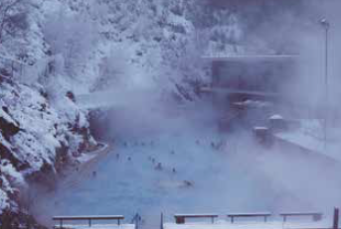
Nuclear Energy
Nuclear energy is transformed into thermal energy inside Earth’s crust.
This thermal energy drives tectonic plates to move and is the source of volcanic activities.
p. 245 Nuclear energy

Slide 7
Gravitational Potential Energy
Gravitational potential energy is used to produce electricity.
The Moon’s gravitational potential energy is the reason why tides exist on Earth.
p. 245 Gravitational potential energy

Slide 8
Discussion Questions
What types of energy contribute to the Earth system?
Which type of energy transformation has the greatest impact on Earth?

Slide 9
Concept 2: Earth’s atmosphere is heated by the transformation and transfer of solar energy and thermal energy.
The Sun gives off solar energy.
This solar energy is transformed into thermal energy.

Slide 10
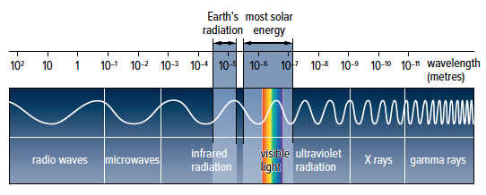
Figure 3.34: Electromagnetic radiation consists of the seven types shown here, from long-wavelength radio waves to short-wavelength gamma rays.
Solar Energy contains infrared radiation, visible light and ultraviolet radiation.
Earth’s radiation is only infrared radiation

Slide 11
Absorption, Reflection, and Radiation of Energy
The Sun’s solar energy consists of visible light, infrared radiation, and ultraviolet radiation.
When visible light is absorbed by Earth’s surface, it is converted into thermal energy.

Slide 12
Absorption, Reflection, and Radiation of Energy
The atmosphere absorbs infrared radiation and traps it as thermal energy.
Infrared radiation plays the largest role in regulating Earth’s temperature.

Slide 13
Absorption, Reflection, and Radiation of Energy (cont’d)
The rest of the solar energy is absorbed, reflected, and scattered by clouds and the atmosphere.

Slide 14
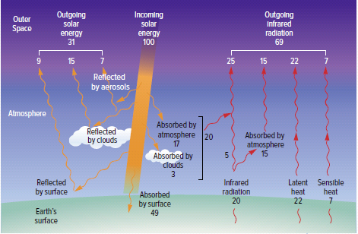
Figure 3.35: Incoming solar energy interacts with Earth’s atmosphere and surface in different ways. This energy diagram is based on 100 units of solar energy
entering the atmosphere. It shows the approximate amounts of energy radiated, reflected, and absorbed.

Slide 15
The Role of Greenhouse Gases
Greenhouse gases warm Earth’s atmosphere and contribute to the greenhouse effect.
Greenhouse gases include carbon dioxide, water vapour, nitrous oxide, and methane.

Slide 16
Conduction and Convection
Conduction: the transfer of thermal energy between two substances that are touching
Collision of molecules in the water and land transfer thermal energy to molecules in the air through conduction.

Slide 17
Conduction and Convection (cont’d)
Convection: the transfer of thermal energy by the movement of heated fluids from one place to another
Convection occurs in the air and distributes thermal energy.

Slide 18
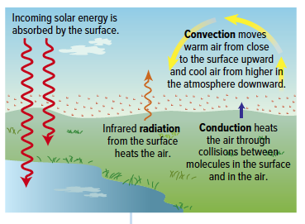
Figure 3.37: Radiation, conduction, and convection all affect atmospheric temperature.

Slide 19
Discussion Questions
Describe the roles played by the following in warming Earth’s atmosphere.
a) radiation
b) conduction
c) greenhouse gases
d) convection

Slide 20
Concept 3: Energy transfer and energy transformation moderate Earth’s temperature.
Water moves among the hydrosphere, geosphere, and atmosphere through:
condensation
precipitation
evaporation
transpiration

Slide 21
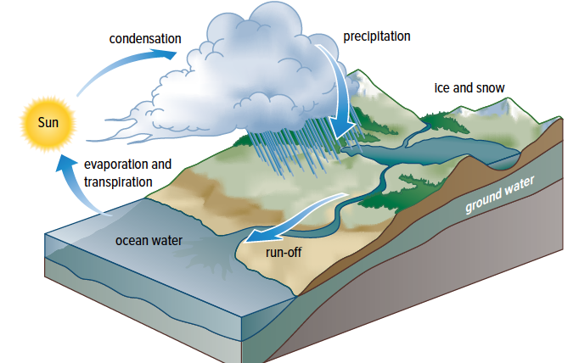
The Water Cycle and Energy
Condensation releases thermal energy into the atmosphere.
Water returns to the surface through precipitation as rain and snow.
When water absorbs thermal energy, it evaporates from Earth’s surface.
Figure 3.38 The water cycle
transports water and energy.

Slide 22
The Water Cycle (cont’d)
Plants take up water from the ground and release it into the atmosphere as water vapour.
This is the process of transpiration.
Figure 3.38 The water cycle
transports water and energy.

Slide 24
Water Moderates Earth’s Temperature
Water absorbs a lot of energy through evaporation.
Evaporation plays a role in cooling Earth.
Specific heat capacity: the amount of energy required to change the temperature of 1 g of a substance by 1 degree Celsius
Water has a high specific heat capacity.
This is why lakes in Dawson Creek stay at around 4 C year round
Therefore, ocean temperatures stay relatively constant.

Slide 25
Discussion Questions
Describe the role energy transformation plays in the water cycle.
What is specific heat capacity?
Why are coastal temperatures more moderate than inland ones?
Coastal temperatures are more moderate because water has a higher specific heat capacity than the land (this means even if land and water absorb the same amount of energy, the land will be warmer than the water. Inland locations do not exhibit the same trend.

Slide 26
Concept 4: Energy transformation and transfer can harm aquatic and terrestrial ecosystems.
Greenhouse gases are causing Earth’s atmosphere to become warmer.
This is leading to the increase in ocean temperature as well.
As a result, aquatic ecosystems are being destroyed and aquatic animals are dying.

Slide 27
Terrestrial Ecosystems
Terrestrial ecosystems are negatively impacted by the increase in radiation exposure.
Radioactive materials and wastes that accumulate in the soil are contaminating terrestrial ecosystems.
Harmful effects are seen as a result of mutations.

Slide 28
Discussion Questions
Explain how climate change is affecting at least one aquatic organism.
Why are radioactive materials so harmful to terrestrial ecosystems?

Slide 29
Topic 3.3 Summary: How does energy transformation affect global systems?
Earth is a system in which energy is transformed.
Earth’s atmosphere is heated by the transformation and transfer of solar energy and thermal energy.
Energy transfer and energy transformation moderate Earth’s temperature.
Energy transformation and transfer can harm aquatic and terrestrial ecosystems.

Slide 30
4 mini labs
Complete the 4 mini labs
Answer the questions for each lab as complete sentences and with as much detail as possible.

