Slide 1
Chemistry 11
Unit III
The Physical Properties
and Physical Changes of Substances

Slide 2
3-1. Some Basic Definitions in Science
Description
  Series of observations used to characterise something
  List of properties of something
B. Data
  Quantitative information, experimentally determined
C. Experiment
  Test or procedure done answer a question or problem
D. Observations:
  The use of all of the senses (sight, taste, smell, hearing and touch) to gather information from and about your surroundings

Slide 3
E. Interpretation:
  Is an inference based on an observation. Brings meaning to an observation. Two types:
Qualitative information is non-numerical information.
Quantitative information is numerical information.
Example | Qualitative Description | Quantitative Description
Your height | tall, short | 180 cm
Your weight | thin, heavy | 123 kg

Slide 4
F. Inference:
  Generally, we draw an inference when we go beyond stated information by applying our background knowledge.
  For example, if we learn that John ran a red light and is being treated for injuries at the local hospital, we can reasonably draw an inference that he was injured in an accident
G. Prediction:
    A prediction is the act of reasoning about the future based on past experience. For example, we can confidently predict that day will follow night.

Slide 5
H. Hypothesis
A hypothesis is a tentative statement that proposes a possible explanation to some phenomenon or event. A useful hypothesis is a testable statement which may include a prediction.

Slide 6
When Are Hypotheses Used?
The key word is testable. That is, you will perform a test of how two variables might be related.
This is when you are doing a real experiment. You are testing variables. Usually, a hypothesis is based on some previous observation such as noticing that in November many trees undergo color changes in their leaves and the average daily temperatures are dropping. Are these two events connected? How?

Slide 7
Formalized Hypotheses example:
If skin cancer is related to ultraviolet light , then people with a high exposure to uv light will have a higher frequency of skin cancer.
If leaf color change is related to temperature , then exposing plants to low temperatures will result in changes in leaf color.

Slide 8
Formalized hypotheses contain two variables.
One is "independent" and the other is "dependent."
The independent variable is the one you, the "scientist" control and the dependent variable is the one that you observe and/or measure the results.
In the statements above the dependent variable is blue and the independent variable is red.

Slide 9
A 500 ml beaker is placed on a counter at one side of the classroom. The beaker is filled to about half full with a liquid and allowed to remain there for one week. During this time you make as many observations and related statements about the beaker and contents as you can. Listed below are some statements that have been made by others. Read their statements and identify which are observations, inferences or hypotheses.
Practicing to identify hypotheses, inferences and observations

Slide 10
On the first day the volume of liquid was about 200 milliliters.
The beaker looks and feels like glass.
The beaker is glass.
The liquid appears clear ; you can see through it.
The liquid has a sweet odor.
Chemical analysis would reveal the presence of peppermint oil in the liquid.

Slide 11
7. All clear, transparent liquids have a sweet odor.
8. On the third day the volume of the liquid was 100 ml
9. 100 ml. of the liquid must have evaporated during the first three days.
10. Someone drank 100 ml. of the liquid during the first three days.
11. Liquids decrease in volume when allowed to stand in an open container for any length of time.
..

Slide 12
I. Scientific theory:
  summarizes a hypothesis or group of hypotheses that have been supported with repeated testing.
  One definition of a theory is to say it's an accepted hypothesis.
  It can be used to explain something.
J. A law:
  generalizes a body of observations.
  At the time it is made, no exceptions have been found to a law.
  Scientific laws explain things, but they do not describe them. One way to tell a law and a theory apart is to ask if the description gives you a means to explain 'why'.

Slide 13
 | Hypothesis | Theory | Law
Single idea | yes | no | no
Testable prediction | yes | yes | no
A temporary idea | yes | no | no
Assumption | yes | no | no
Broad generalizations | No | Yes | Yes
Explains WHY something occurs | no | yes | no
Summarizes past results of experiments | no | no | yes
Predicts what will happen in NEW situations | No | yes | no
Predicts what will always happen in a KNOWN situation | No | No | yes

Slide 14
3-2. The Physical Properties of Matter
Matter:
  Anything that has mass and occupies space
  If it is not matter it is ENERGY (which is also observable)
Substance:
  A unique and identifiable set of properties
Chemical Property:
  the ability of a substance to undergo chemical reactions and change into a new substance
Physical Property:
  Can be found without creating a new substance

Slide 15
  There ARE TWO TYPES OF PHYSICAL PROPERTIES:
  Extensive Physical Property:
depends on the amount of substance present
NOT used to identify a substance
ie – mass and volume are extensive
  2.Intensive Physical Property:
  depends on the nature of the substance
does NOT depend on how much is present
used to identify substances
    ie – density and melt temp are intensive

Slide 16
Examples | Intesive or Extensive?
Density | I
Colour | I
Smell | I
Melting point | I
Mass | E
Temperature | I
Volume | E
Solubility | I

Slide 17
States of Matter
Definite Volume?
Definite Shape?
Temp. increase
Com-pressible?
Small Expans.
Solid
YES
YES
NO
Small Expans.
Liquid
NO
NO
YES
Gas
Large Expans.
NO
NO
YES

Slide 18
Condense
Freeze
Melt
Evaporate
Solid
Liquid
Gas

Slide 19
States of Matter
There are more
Plasma
  high temperature low pressure
  electrons separate from nucleus
  Most common in the universe
More at very low temp
  Bose- Einstein condensate
  Quantum superfluids

Slide 20
Physical properties definitions:
Hardness
  the ability to resist abrasion or scratching
Malleability
  the ability to be rolled or shaped into thin sheets
Ductility
  the ability to be stretched or drawn into wires
Lustre
  the manner in which a solid reflects light
  Terms include: metallic, adamantine, glassy, oily, pearly, silky or dull

Slide 21
Viscosity
  the resistance of a fluid to flow (low = fast, high = slow)
Diffusion
  the intermingling of fluids as a result of motion within the fluid (gases and liquids)
Vapour
  gaseous material formed by the evaporation of a substance which boils above room temperature
  If a substance boils below room temperature it is called a gas (see the periodic table)
Vapour pressure
  the pressure created by the vapour evaporating from a liquid

Slide 22
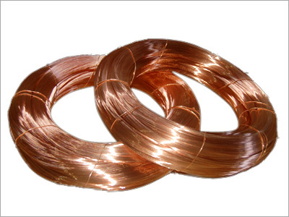
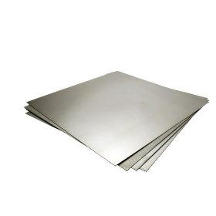
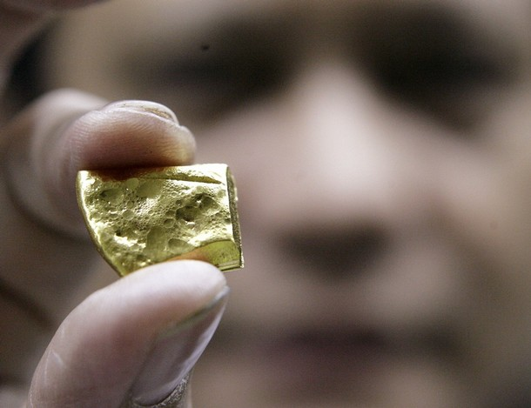
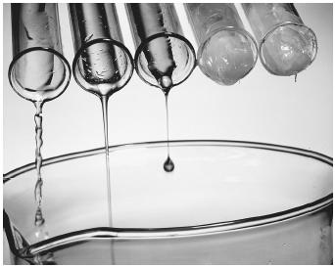
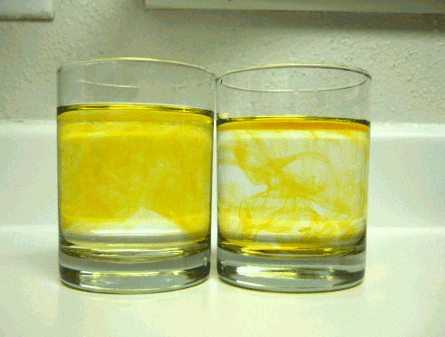
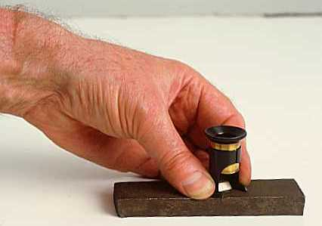
Ductile
Malleable
Lustre
Viscosity
Hardness
Diffusion

Slide 23
Assignment: pg44-49 # 13, 14, 15, 17 (not ‘e’), 18, 19, 20, 21, 22, 24, 29, and 31

Slide 24
3-3. The Classification of Matter
Definitions:
Particle
  A general term used to describe a small bit of matter
Atom
  The smallest possible unit of an element which retains the fundamental properties of the element
Element
  A substance which cannot be separated into simpler substance as a result of any CHEMICAL process
  Only 1 type of atoms present

Slide 25
Molecule
  a cluster of 2 or more atoms held together strongly by electrical forces
Compound
  A pure substance made of more than 1 type of atom
  Only one type of molecule is a compound

Slide 26
If a single particle is a/an: | Then a large-scale, visible collection of these particles is called:
Atom or Molecule made of identical atoms | Element
Molecules made of different atoms | Compound

Slide 27
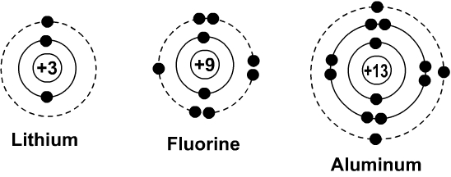
What is an ion?
An atom is a neutral particle because it contains an equal number of electrons (neg charge) and protons (positive charge)
Lithium will loose 1 electron to become 1+ (dotted line will disappear with the 1 circle) | Fluorine will gain an electron and become 1- (the dotted line will stay and gain a circle) | Aluminum will loose 3 electrons and become 3+ (dotted line will disappear with the 3 circles)

Slide 28
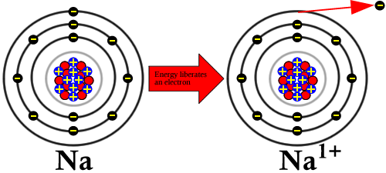
In an ion, the number of electrons has changed.
Atoms GAIN or LOSE electrons to become more stable (a full outer shell). The number of protons NEVER change, only the number of electrons https://www.youtube.com/watch?v=Bfg9pq3Whmw

Slide 29
What is the charge of the ion?
Atom | Change in electrons | Ion charge
Al | Lost 3 | +3
O | Gained 2 | -2
Cu | Lost 1 | +1
Br | Gained 1 | -1
P | Gained 3 | -3
When an atom loses electrons, it becomes positive and when it gains electrons it becomes negative Metals lose electrons and non-metals gain electrons

Slide 30
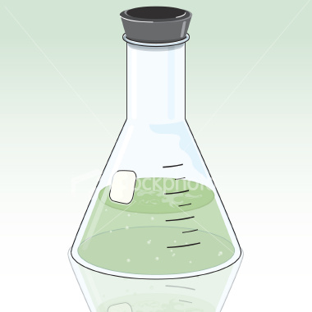

Classification of matter
System: the part of the universe being studied in a given situation
Surroundings: everything except the system
Universe: Everything including the system
Phase: is any part of a system which is UNIFORM in both its composition and properties

Slide 31
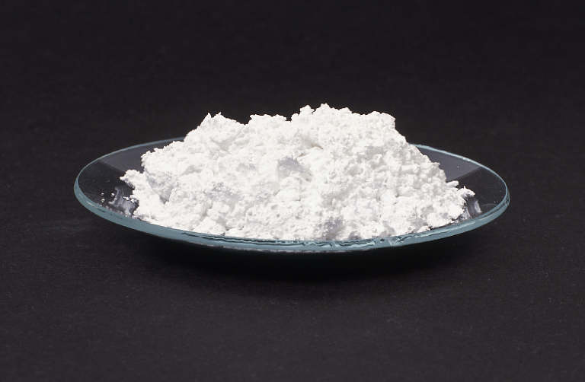
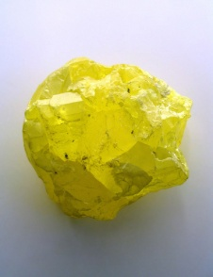
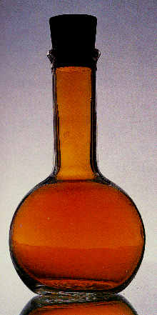
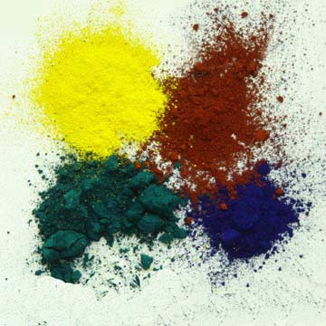
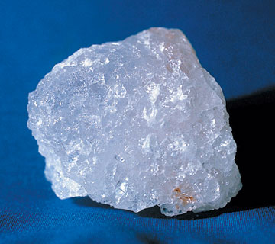
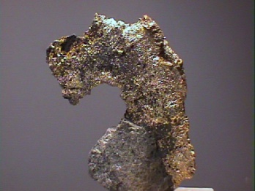
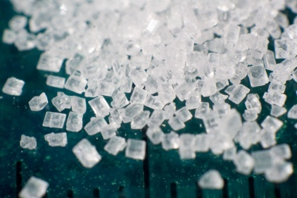
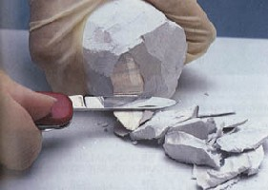
Homogenous Substance
  substance with only 1 phase
Pure substance
  homogenous + unchangeable and uniform composition
    Compound
    Element
Prefix Homo- means all the same

Slide 32

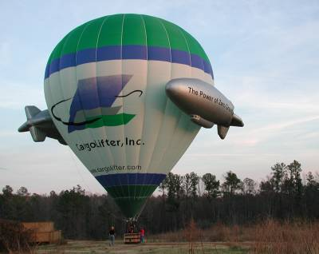
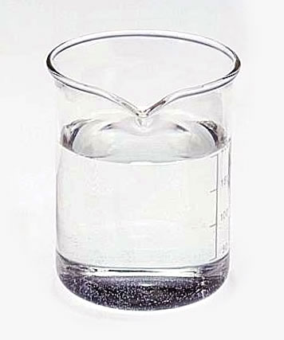
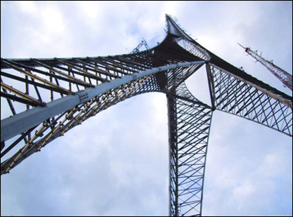
Homogeneous Mixture
  made up of 2 or more substances (uniform composition ) in varied amounts
Solution
  homogeneous mixture of 2 or more substances

Slide 33
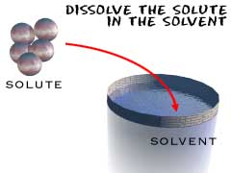
Solution Review
Aqueous (solvent is water)
Solvent (does the dissolving/exist in the greater quantity) ex. water
Solute (is dissolved/exist as the smaller quantity) ex. salt, sugar, acids, bases, etc.

Slide 35
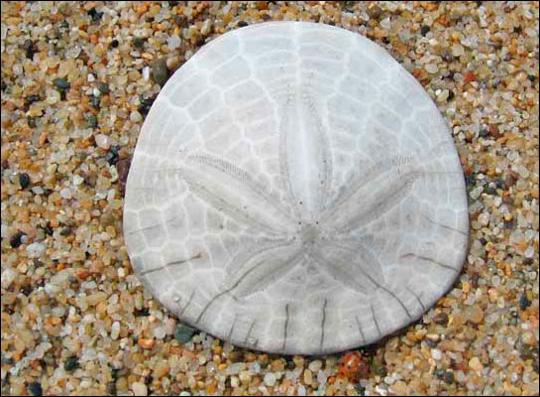
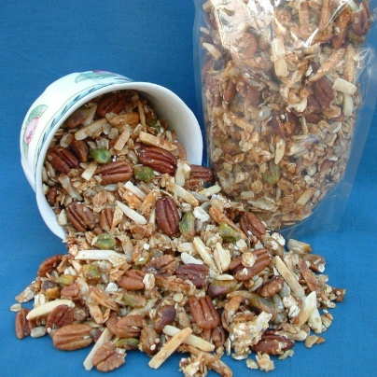
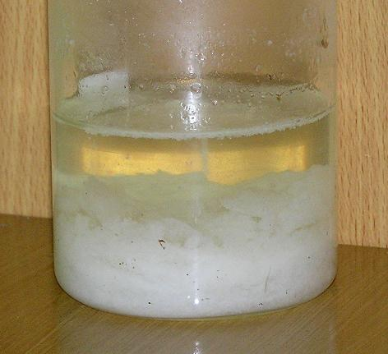
Heterogeneous Substance
  substance with more then one phase (different physical properties)
Mechanical Mixture
  Heterogeneous mixture of 2 or more visible substances
  Suspensions (milk, blood, Ketchup, OJ, TJ)
  Precipitates (OJ with pulp, TJ with pulp, Silty water)

Slide 36
Classification of Substances
All Substances
Homogeneous
Substances
Pure Substance
Element
(1 type of atom present)
Compound
(More then 1 type of
atom present)
Homogeneous
Mixture
Solution
Heterogeneous
Substances
Mechanical Mixtures

Slide 37
Assignment: page 52 # 33 - 44

Slide 38
3-4 The Physical Separation of Substances
The methods examined in this section take advantage of differences in the physical properties of the substances involved

Slide 39
    Mechanical Mixtures
Mixture | Method | When to Use Method
Solid in Solid (Heterogeneous) | Hand Separation | Large chunks present among other solids
 | Gravity Separation | The density of the desired solids is much different form the density of the other solids.
 | Solvent Extraction | One solid preferentially dissolves in a particular solvent.
 | Chromatography | The solids are coloured, present in small amounts and are soluble in some solvent or mixture of solvents

Slide 40
Solid in Liquid (Heterogeneous) | Hand Separation | A few large pieces of solid are present in the liquid.
 | Gravity Separation | Solid particles are present in a small amount of liquid.
 | Filtration | Solid particles are present in a large amount of liquid.

Slide 41
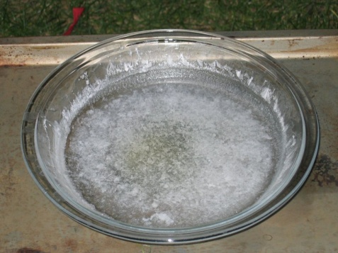
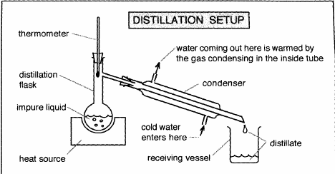
B. Solutions
Mixture | Method | When to Use Method
Solid in Liquid (Homogeneous) | Evaporation | The solid is wanted and the liquid is not.
 | Distillation | The liquid is wanted; the solid may or may not be wanted.

Slide 42
Mixture | Method | When to Use Method
 | Solvent Extraction | An immiscible added solvent preferentially dissolves at least one but not all the solids present.

Slide 43
Mixture | Method | When to Use Method
 | Recrystillization | One dissolved solid is much less soluble than the others present (if any); the liquid is not wanted.
 | Chromatography | Small amounts of the more than one coloured solid are present; the liquid present is not wanted.

Slide 44
Liquid in Liquid (Homogeneous) | Distillation | Two or more liquids are present and have different boiling temperatures.
 | Solvent Extraction | An immiscible added solvent preferentially dissolves at least one but not all of the liquids present.

Slide 45
Assignment: Ex.) 45, 46, 47, 51, 52, 53, 57 and 58

Slide 46
3-5 Phase Changes
Chemical and Physical Changes:
CHEMICAL CHANGE:
A change in which new substances are formed.
Produces a set of chemicals which is different from the set of chemicals which existed before the change.
Examples include:
Noticeable heat or light is produced.
A colour change is observed.
One of the original materials is used up.
Bubbles may appear, which shows that a new gas may be forming.
Cloudiness may result; this shows that a solid is forming (a precipitate).

Slide 47
PHYSICAL CHANGE:
A change in the phase of a substance, such that no new substances are formed.
A physical change does not change the set of chemicals involved.
Examples:
Solid chunk→ powder
Dissolving
Any phase change

Slide 48
Phase changes:
MELTING TEMPERATURE (MP)
  The temperature where solid changes to liquid
FREEZING TEMPERATURE (FP)
  The temperature where liquid changes to solid.
  At the MELTING/FREEZING TEMPERATURE, the solid and liquid phases co-exist.
BOILING TEMPERATURE (BP)
  The temperature where liquid changes to gas.
CONDENSATION TEMPERATURE (CP)
  The temperature where gas changes to liquid.
  At the BOILING/CONDENSATION TEMPERATURE, the liquid and gas phases co-exist.
NOTE: The temperature does not change during a phase change (such as melting and boiling).

Slide 49
Continued heating of a pure solid substance produces the following temperature behavior

Slide 50
There is a steady decrease in the amount of solid as the amount of liquid increases. At the start of the phase change the substance is 100% solid, then more and more liquid forms. Eventually, the last bit of solid melts and the phase change is complete as shown by the graph below:

Slide 51

Assignment: Ex.) 64 - 71

