Slide 1
Lesson 2.2 and 2.3
Metric Prefixes
(pages 16-23)

Slide 2
2.2 and 2.3 Learning Outcomes
Recognize base units
Recognize metric prefixes
To create CF by comparing base units to a metric prefix
To solve simple (1 CF) and complex (2 or more CF) metric conversion problems

Slide 3
Key Vocabulary Words
SI units
Metric prefix
Base unit
Metric conversions
Derived unit
Derived quantity

Slide 4
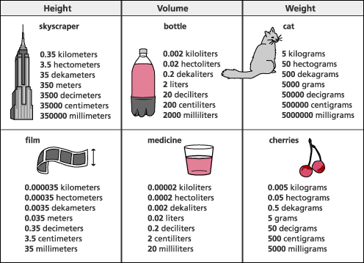
Metric Prefixes

Slide 5
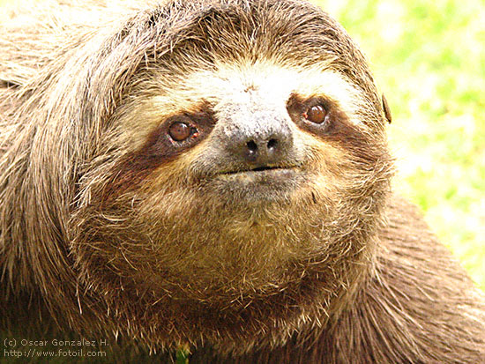
Some more uses of metric prefixes
mass of Earth = 5.9742 × 10²⁴ kilograms (kg) = 5.9742 x 10¹⁸ Gigagrams
We spend 1/3 of our life sleeping, that is 27.37 years, 8.6 x 10⁸ seconds or 8.63 x 10² megaseconds (863 Msec)
A Sloth’s top speed is 5 m/min = 0.3 km/hr or 5000 mm/min, or 83 mm/sec

Slide 6
2.2 Summery Notes:
The International System of Units is the modern form of the metric system
devised around the convenience of the number ten.
world's most widely used system
Base units: a basic unit of measurement, all other units are multiples of the base unit
The base units are: Meter-m, gram-g (kg is the actual SI unit… but in Chemistry we use the gram), second- s, mole- mol, litre- L, tonne- t
Prefixes are multiples of base units (see SWB for all prefixes)

Slide 7
Example: | Written prefix | Prefix symbol | Unit | Unit symbols | Exponential equivalent
cm | centi | c | meter | m | 10⁻²
kilogram
kmol
Gg
ms
micrograms
dm

Slide 8
Example: | Written prefix | Prefix symbol | Unit | Unit symbols | Exponential equivalent
cm | centi | c | meter | m | 10⁻²
kilogram | kilo | k | gram | g | 10³
kmol | kilo | k | mole | mol | 10³
Gg | giga | G | gram | G | 10⁹
ms | milli | m | seconds | s | 10⁻³
micrograms | micro | u | grams | g | 10⁻⁶
dm | deci | d | metre | m | 10⁻¹

Slide 9
2.3 Summery Notes
1. Sample Question: How many micrometers are there in 5 cm?

Slide 10
2.3 Summery Notes
1. Sample Question: How many micrometers are there in 5 cm?
Plan: cm→m→um

Slide 11
2.3 Summery Notes
1. Sample Question: How many micrometers are there in 5 cm?
Plan: cm→m→um
# um = 5 cm x 1 x 10⁻² m x 1 um 1 cm 1 x 10⁻⁶ m
= 5 x 10⁴ um

Slide 12
2. For every METRIC conversion use the following steps: U = I x CF
Identify the U and units
Identify the I and units
Identify all the CF(s)
Solve
For every metric conversion you must first convert into the base unit
In the CF, the prefix will always get the “1” and the base will always get the exponential equivalent value
When you have a question that requires more than one CF… make a plan!!

Slide 13
The Metric Spider!!
Get out your data booklet!!

Slide 14
The Metric Spider!!
Metric Prefixes
Base Units

Slide 15
Giga
G
nano
n
Mega
M
micro
u
m
mol
L
s
**g
t
Kilo
k
milli
m
hecto
h
centi
c
deka
da
deci
d

Slide 16
Giga
G
nano
n
=
=
Meg
M
10⁹
10⁻⁹
micro
u
m
mol
L
s
**g
t
=
=
10⁶
10⁻⁶
Kilo
k
=
10⁻³
milli
m
10³
=
10²
10⁻²
hecto
h
=
=
centi
c
10¹
=
10⁻¹
deka
da
=
deci
d

Slide 17
See SWB pages 19-21 for examples

Slide 18
1. ONE STEP METRIC CONVERSIONS
Example 1:
a) Convert 9.4 nm into metres.

Slide 19
1. ONE STEP METRIC CONVERSIONS
Example 1:
Convert 9.4 nM into metres (nM→ m).
# m = 9.4 nM x 1 x 10⁻⁹ m
1 nM

Slide 20
1. ONE STEP METRIC CONVERSIONS
Example 1:
Convert 9.4 nM into metres (nM→ m).
# m = 9.4 nM x 1 x 10⁻⁹ m= 9.4 x 10⁻⁹ m
1 nM

Slide 21
2. TWO STEP METRIC CONVERSIONS
TWO PREFIXES in the question.
These require the use of 2 CF.
Always convert to the base unit first.
Example 2:
Convert 6.32 um into km.

Slide 22
2. TWO STEP METRIC CONVERSIONS
Example 2:
Convert 6.32 um into km (um→m→km).
#km = 6.32 um x 1 x 10⁻⁶ m x 1 km
1 um 1 x 10³ m

Slide 23
2. TWO STEP METRIC CONVERSIONS
Example 2:
Convert 6.32 um into km (um→m→km).
#km = 6.32 um x 1 x 10⁻⁶ m x 1 km
1 um 1 x 10³ m
= 6.32 x 10⁻⁹ km

Slide 24
3. DERIVED UNIT CONVERSIONS
Example 3:
Convert 55.0 km/h into m/s.

Slide 25
3. DERIVED UNIT CONVERSIONS
I
U
Example 3:
Convert 55.0 km/h into m/s.
CF’s:
1 km 60 sec 1 h
1 x 10³ m 1 min 60 min
Plan 1: Convert the numerator first:
Km→ m,
Plan 2: Convert the denominator second:
h→ min → s

Slide 26
3. DERIVED UNIT CONVERSIONS
Example 3:
Convert 55.0 km/h into m/s.
# m/s = 55.0 km x 1x10³ m x 1 h x 1 min
h 1 km 60 min 60 sec
= 15. 3 m/s

