Slide 1
Chemistry 9 Review
Book 4: The Bohr Model and Periodic Trends

Slide 2
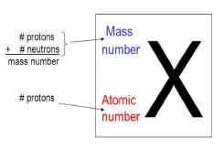
Part A The Bohr Model
Protons and neutrons are found in the nucleus of an atom
Using Standard Atomic Notation
On the upper left of the element symbol is the atomic
mass(rounded to the nearest whole number)
On the lower left of the element symbol is the atomic
number (number of protons).
Ex. Consider the element gold. Its symbol is Au. Its mass number is 197 and its atomic number is 79.
Written in standard atomic notation it becomes:

Slide 3
Practice Write the standard atomic notation for geranium, uranium and cobalt

Slide 4
Write the standard atomic notation for germanium, uranium, and cobalt.
${}_{32}^{73}{Ge}$
${}_{92}^{238}U$
${}_{27}^{59}{Co}$

Slide 5
Modeling Atoms with Bohr Diagrams
Atoms are so SMALL that in order to study them, we need to create MODELS
The current atomic model is known as the “ELECTRON CLOUD MODEL” Electrons are always moving in 3D space around the NUCLEUS
The model that we will learn today represent the atom at A MOMENT IN TIME
It’s a way of representing the MOST LIKELY LOCATION of electrons in the “cloud”
It’s important to remember that an atomic model is a SIMPLIFIED version of an atom, and it’s completely WRONG in terms of SCALE

Slide 6
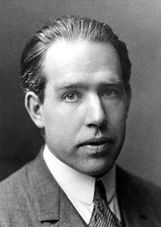
Bohr Diagrams
A Bohr diagram is a diagram that shows how many ELECTRONS are in each shell surrounding the nucleus.
Named in honor of NIELS BOHR, a Danish physicist who developed several models for showing the arrangement of electrons in atoms.
There are three main background questions to explore before we start drawing Bohr diagrams.

Slide 7
1. Parts of a Bohr Diagram
Colour electrons yellow and the nucleus blue (includes the protons and neutrons) and the electron shells in red
The element is Neon

Slide 8
2. How does an Electron’s LOCATION Correspond to its ENERGY?
Imagine climbing a LADDER. As you go up each rung, you gain more and more ENERGY
This is similar to the way in which electrons have MORE energy as they orbit FURTHER from the nucleus
The shells of an atom are named K, L, M, and N going from CLOSEST to furthest from the NUCLEUS

Slide 9
3. How do ELECTRONS fill the SHELLS?
Shell | Level | # of electrons to be full
K | 1 | 2 max
L | 2 | 8 max
M | 3 | 8 max
N | 4 | 18 max
The row number on the periodic table = the number of shells
Row 1 = 1 shell (starts with Hydrogen)
Row 2 = 2 shells (starts with Lithium)
Row 3 = 3 shells (starts with Sodium)
Row 4 = 4 shells (starts with Potassium)
Row = Period
Column = Group = Family

Slide 10
Drawing a Bohr Diagram
Write the element’s SYMBOL with the MASS NUMBER at the TOP left and the ATOMIC NUMBER at the BOTTOM left
CALCULATE the number of NEUTRONS in the atom. Write the number of protons (p+) and neutrons (n0) as the NUCLEUS
THINK: How many electrons does the NEUTRAL atom have?
# protons = # electrons
DRAW the K shell. Fill the K shell with the first 2 electrons. Make your electrons nice and BIG!
Continue drawing each shell and FILLING with electrons until you have accounted for all the atom’s electrons.

