Slide 1
Section 24.4 Water Resources
Pages 693 to 697

Slide 2
Properties of Water
71% of the Earth’s surface
Why is water important?
Regulates climate
Creates Marine Habitats
Dilutes pollutants
Degrades pollutants

Slide 3
Properties of water
Fresh Water Uses
Agriculture
Transportation
Recreation
Other Human Activities
Animals are comprised of 50 to 65 % water
Trees are composed of 60% water

Slide 4
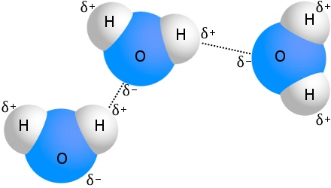
Liquid Water
Water has a high boiling point (100ºC)
Low freezing point (0ºC)
Remains a liquid in most places on Earth
The reason it remains as a liquid is due to hydrogen bonds (Figure 16 page 693)
Hydrogen bonds also allow water to stick to solid surfaces including leaves and roots of plants

Slide 5
Thermal Energy storage capacity
Water can absorb a large amount of thermal energy before it changes temperature
This allows for water to regulate temperature
Examples
Water is used as a coolant in many processes
Engines, powerplants, etc.
Water in perspiration cools the human body when we get too hot

Slide 6
Water as a solvent
Water can dissolve many different substances
Nutrients for organism
Movement of nutrients into cells
Cell pressure (to maintain the shape)

Slide 7
Solid Water
Frozen water is less dense than liquid water
This means ice floats on the surface
Water freezes from the top down
Organisms therefore can live under the ice
Ice can break solid surfaces helping with erosion and the rock cycle

Slide 8
Location of Fresh water Resources
Fresh Water is not distributed equally over the planet’s surface
Look at Figure 18 on Page 694

Slide 9
Use of Freshwater Resources
70% is used in farming (Irrigation)
23% power plants, oil and gas production and industrial processing
7% domestic and municipal uses

Slide 10
Managing Freshwater Resources
Building Dams, transporting surface water and tapping ground water
Dams and reservoirs
Is to prevent flooding
Resources like energy (electricity)
We can use the reservoirs for leisure activities
Controlled release of water

Slide 11
Managing Freshwater Resources
transporting surface water
Aqueducts
Pipes
Tunnels
Transport water into homes and businesses

Slide 12
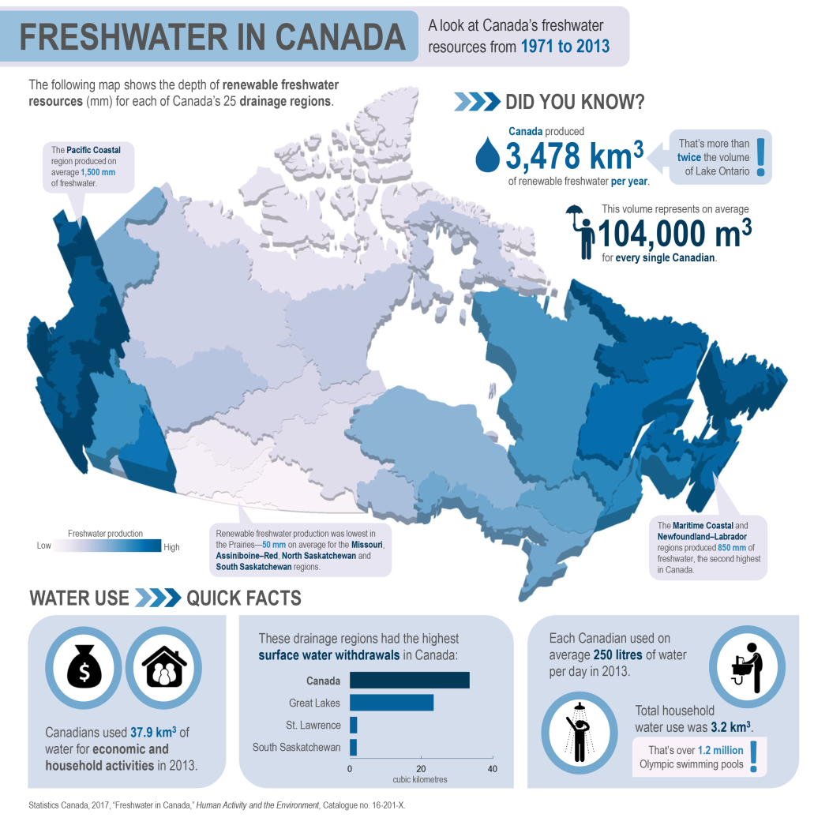
Fresh water distribution in Canada

