Slide 1
Igneous Rocks Chapter 5

Slide 2
How are Igneous Rocks Formed?
Igneous rocks from when lava or magma cools and crystalizes
Melting point of rocks is between 800ºC and 1200ºC

Slide 3
Elements that make up magma and the Earth’s crust
Oxygen (O)*
Silicon (Si)*
Aluminum (Al)
Iron (Fe)
Magnesium (Mg)
Calcium (Ca)
Potassium (K)
Sodium (Na)
*Note the most abundant

Slide 4
Silica
Silica content affect the melting temperature and impact a magma’s viscosity, or resistance to flow

Slide 5
Composition of Magma and Lava
The chemical composition of lava is slightly different than the chemical composition of the magma from which it developed
The reason this is the case is that when the magma reached the surface the gases contained in it were released as it solidified.

Slide 6
Magma Formation
The four main factors involved in the formation of magma are temperate, pressure, water content, and mineral content of the crust or mantle.

Slide 7
Four factors affecting magma formation
Pressure increases with depth
As pressure increases melting point increases (rock melting at 1100ºC on the surface to 1400ºC at 100km depth)

Slide 8
Four factors affecting magma formation
Most rocks contain a certain percentage of water
As the water content increases the melting point decreases
1100ºC to 1000ºC

Slide 9
Four factors affecting magma formation
Mineral Content
Rock | Minerals | Melting point
Basalt | Olivine, calcium feldspar, pyroxene | Higher melting point than granite
Granite | Quartz, potassium feldspar | Lower melting point than basalt
Rock | High in iron and magnesium | Higher melting point than rocks containing silicon

Slide 10
Partial Melting
Some elements/minerals melt at different temperatures.
As not all of the rock melts at the same temperature, the magma changes in composition as some elements/minerals are melted and some are still a solid.
This is why there are so many different igneous rocks.

Slide 11
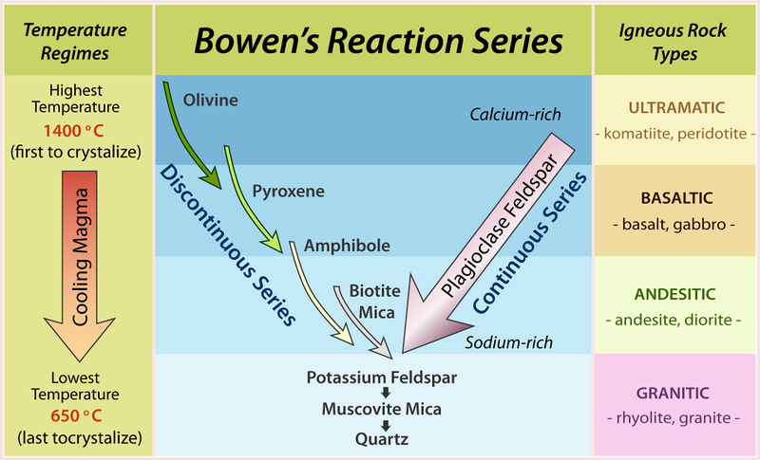
Bowen’s Reaction Series
Notes:
https://jonathanlms96.wordpress.com/2017/03/20/bowens-reaction-series-simplified/

Slide 12
Fractional Crystallization
It is the opposite to partial melting.
Different elements/minerals crystalize at different times.
This process leads to the formation of crystalized areas within rocks that have distinctly different properties.

Slide 13
Questions from page 117:
2. List the 8 major elements present in most magmas. Include the chemical symbol of each element.
4. Compare and contrast magma and lava.

