Slide 1
Manipulating and Testing Digital Media Notes
Media 8

Slide 2
What is Manipulating Digital Media?
To manipulate digital media means that the sequence of events can be modified to create a different perspective.
Every aspect plays a role when creating an animated sequence. You need to create 3 animations using PowerPoint and make subtle changes.
Below are the steps to create a PPT and then animate the slides

Slide 3
Open PowerPoint

Slide 4
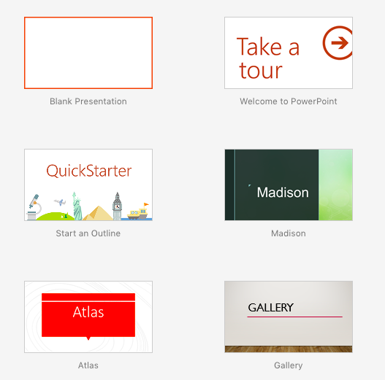
Choose blank Presentation

Slide 5
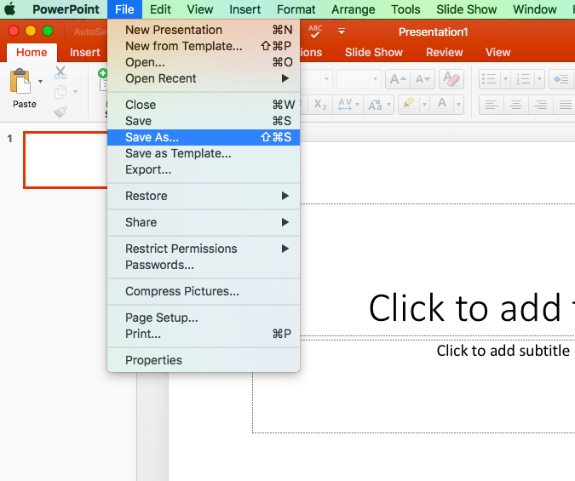
Click File then Save As

Slide 6
Save the file as your name plus Manipulating Digital Media
For Example, Ms Bandali Manipulating Digital Media (make sure you title has no symbols)
Make sure to save it into your home folder (NOT the desktop)

Slide 7
The first slide should look like the example below

Slide 8
Create 3 more slides (a total of 4 slides including the title slide)

Slide 9
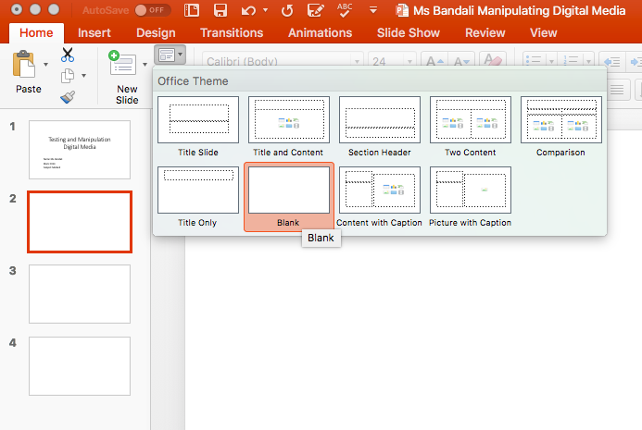
Select the second slide and change it from a title and a textbox to blank following the steps in the image below

Slide 10
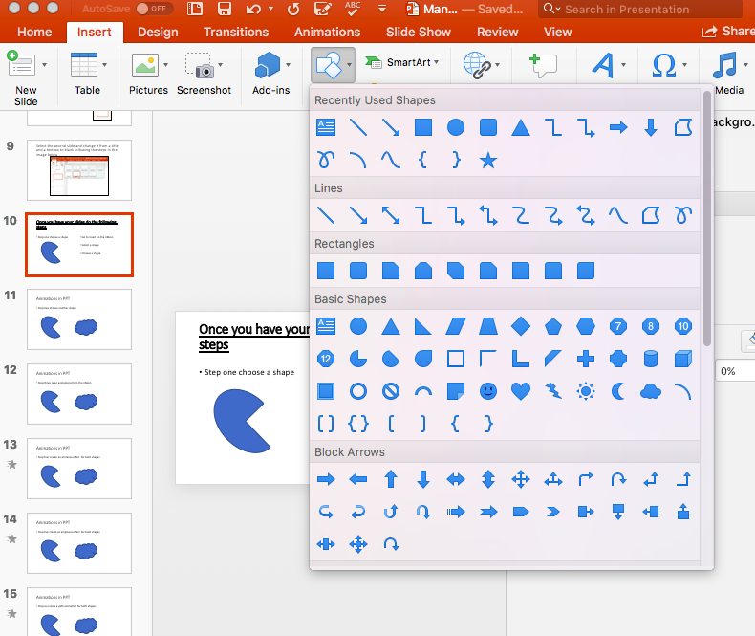
Once you have your slides do the following steps
Step 1:
Go to insert on the ribbon
Select a shape
Drag the shape onto the slide and make it the size you want
You can also change the shape’s colour and outline

Slide 11
Step 2: choose another shape

Slide 12
Step 3: open animations from the ribbon

Slide 13
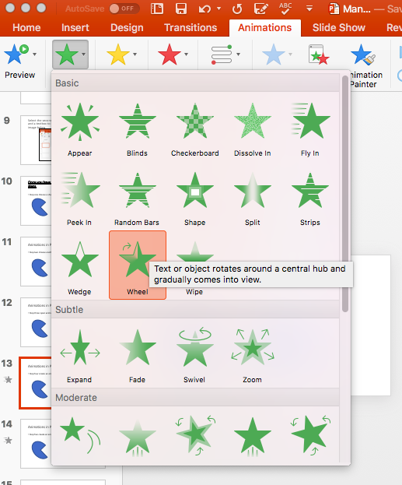
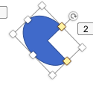
Step 4: create an entrance effect for both shapes (must select each shape to add the animation)

Slide 14
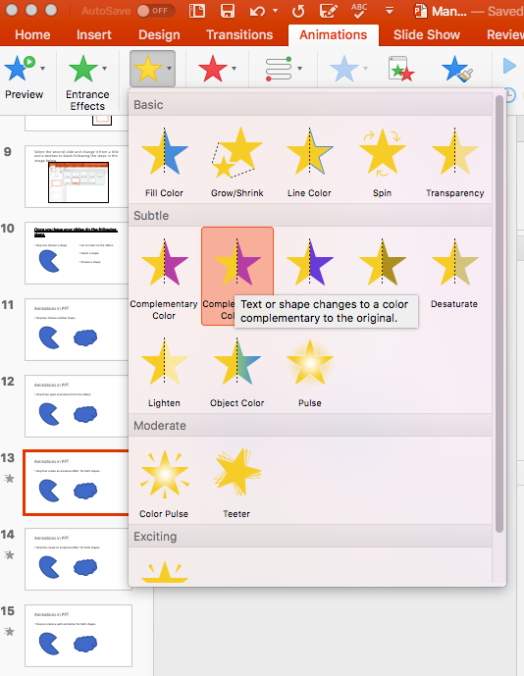
Step 5: create an emphasis effect for both shapes (must select each shape to add the animation)

Slide 15
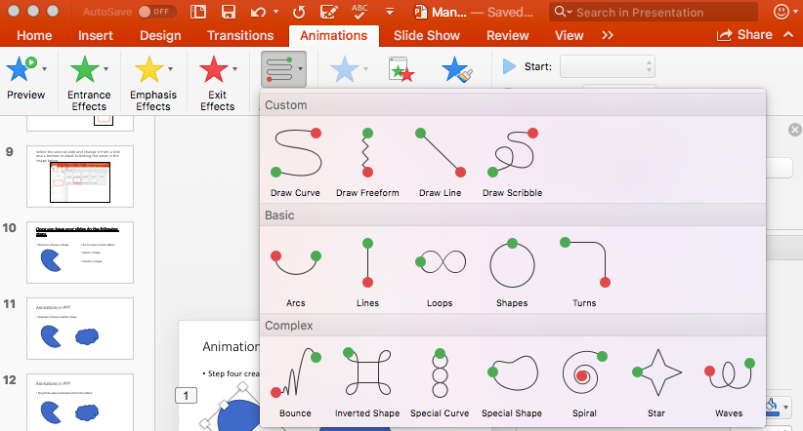
Step 6: create a path effect for both shapes (must select each shape to add the animation)

Slide 16
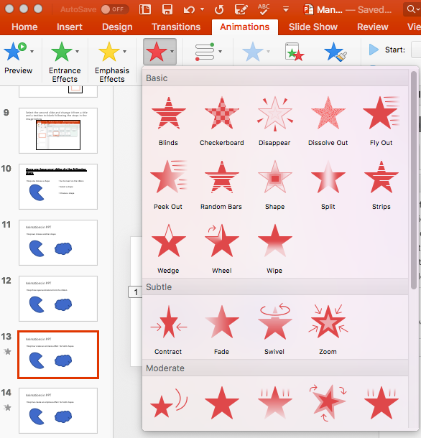
Step 7: create an exit animation for both shapes (must select each shape to add the animation)

Slide 17
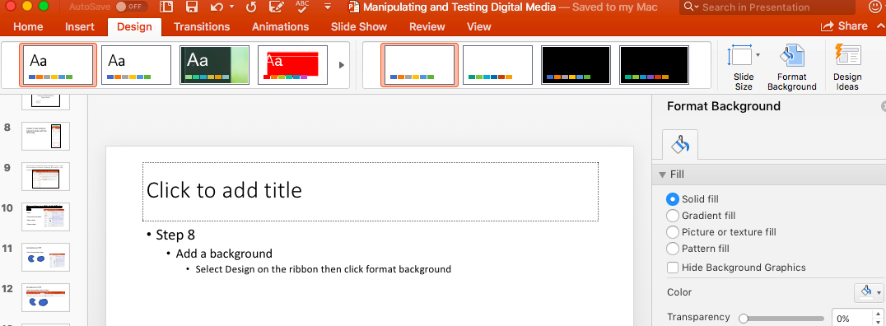
Step 8: Add a background
Select Design on the ribbon then click format background

Slide 18
Step 9: Create 3 animations that have only subtle changes.
Step 10: test your animations out before showing me the final version.
Step 11: drop-box your assignment.

