Slide 1
Mindfulness and Meditation

Slide 2
Disclaimer
This workshop is not a replacement for seeing a psychiatrist or psychologist for mental health issues
This workshop is not a replacement for seeking medical attention when required.
Strong emotions may be brought up during this process and seeking additional help and resources is strongly recommended.

Slide 3
Welcome:
Welcome to the workshop we are currently on ___________________ territory

Slide 4
Important Considerations
Mindfulness only works when you believe in the process.
Buy in is necessary to help students try mindfulness
Mindfulness can impact the following areas:
Lifestyle
Eating – meals and/or snacks
Connecting oneself to nature/universe
Mindfulness can appear to be a spurious notion, rather it is the ability to use one’s mind more attentively
The fallacy of multitasking becomes evident when one uses mindfulness as focusing one’s mind on a single task makes the person much more productive

Slide 5
Important Considerations Continued
Mindfulness helps us to slow down our crazy busy lives and to realize that doing nothing is still doing something as the body is always active.
Mindfulness helps us to connect with each other on a much deeper level as it enables us to express our feelings in a much more insightful way.
Mindfulness helps us to register when our bodies are hungry compared to hunger created by boredom and a variety of negative emotions

Slide 6
Important Considerations Continued
To employ mindfulness in a classroom it will take strategic planning to implement.
First you need to know your class well to see how they will engage in the process.
Mindfulness will need to be practiced daily in the classroom; the amount of time used can vary.
The first few mindfulness lessons can be rocky as students may resist; this can be accommodated by trying a variety of mindfulness practices.

Slide 7
Meditation Teacher Guidelines
Meditation is one form of mindfulness, but it is not always easy to get students to engage in mediation
It is useful to try the meditations yourself before trying them with students.
Meditations can range in terms of difficulty to participate in
The goal is to help students become more aware
The easiest way to start is with short specific medications that guide the students through the steps
For example, healing light meditations focus on specific energy forms and exposing your body to these forms of healing.

Slide 8
Meditation Lesson

Slide 9
Meditation Set Up
Make sure you have no interruptions (assemblies, fire drill, lock down drill, etc.)
Make sure the room is set up to be as quiet as possible
Limit how bright the lightning is in your classroom
You will be observing the group not participation in the meditation
Your voice modulation if you are guiding the meditation needs to be soothing and monotone (a video is the best choice if this is an area where you struggle)

Slide 10
Technique #1 – healing light meditation
The practice is best done seated.
Take a handful of deep, calming breaths. Let each exhalation be a “letting go” of any bodily tension.
Imagine a small point of white light at your solar plexus (about two inches above your navel aka belly button). It represents pure, rejuvenating energy.
At a pace that suits you, imagine the light gently expanding with each inhalation, grow brighter as it does so.
Continue until the light fills your whole body. Then allow it to expand beyond the borders of your body to emanate out in all directions.
Dwell in the presence of this healing light for as long as you wish (set time limit)
If you have been feeling particularly strained, you may wish to visualize the light clearing away these negative feelings in your body.

Slide 11
Technique #2 – healing light meditation
This practice can be done either lying down or sitting.
On your next inhalation, imagine that a gentle stream of white light is flowing into the base of your spine, following its path up your back and into and out of the top of your head.
On the exhalation imagine this white light beginning at your head, down your spine, and out of your body at the base.
Visualize it as cleaning the body of any impurities (negative thoughts and emotions) as it flows up and down.
You may wish to simply focus on the sensations instead of visualizing white light.

Slide 12
Technique #3 – Positive Mantra Meditation
This practice can be done seated.
In this technique students repeat out loud or in their mind the following Mantra
I am present
I am capable
I can succeed
The mantra can be repeated many times (20 to 30 times).

Slide 13
Technique #4: Your Favorite Place
Today we are going to think about our favorite places. As we begin close your eyes and take a deep breath in through your nose and out through your mouth. As you continue breathing slowly, think of one of your favorite places to go . It can be anywhere outside, inside, near us or far away. It can be somewhere you have been a lot, or somewhere you have been only once. I want you to really focus on picturing it in your mind. What does it look like? What can you notice about it? Does it have any certain sounds? Is it a loud place or a quiet place? Do you notice any smells there? Try to think about everything you can notice. Now, focus on how this place makes you feel. Does it make you feel calm? Happy? Excited? Something else? Really think about this feeling. Continue to breathe slowly and focus on the feeling it is giving you. When you are finished, take a deep breath in through your nose and out through your mouth, and then slowly open your eyes.

Slide 14
Mindful Meditations Video Links
Mindfulness Meditation - Guided 10 Minutes - Honest Guys
https://www.youtube.com/watch?v=6p_yaNFSYao
Short Guided Healing Meditation
https://www.youtube.com/watch?v=HEYnJ7mxy7Y
10 Minute Guided Body Scan Meditation from The Meditation Coach
https://www.youtube.com/watch?v=obYJRmgrqOU

Slide 15
Mindful Eating
Mindful eating
This is the practice of eating responsibly
This technique can be a challenge for some students
Some students my require being spoken to before starting
This includes letting them know that they need to write down their reactions to the process rather than vocally saying what they think
Knowing student’s allergies is extremely important and it strongly recommended not to use any products from nut family
Need to start with some small like a raisin, a piece of apple, a chocolate chip, etc.
There needs to be enough of the snack for each person to have 2 pieces
Mystery foods can also be used

Slide 16
Mindful Eating Lesson

Slide 17
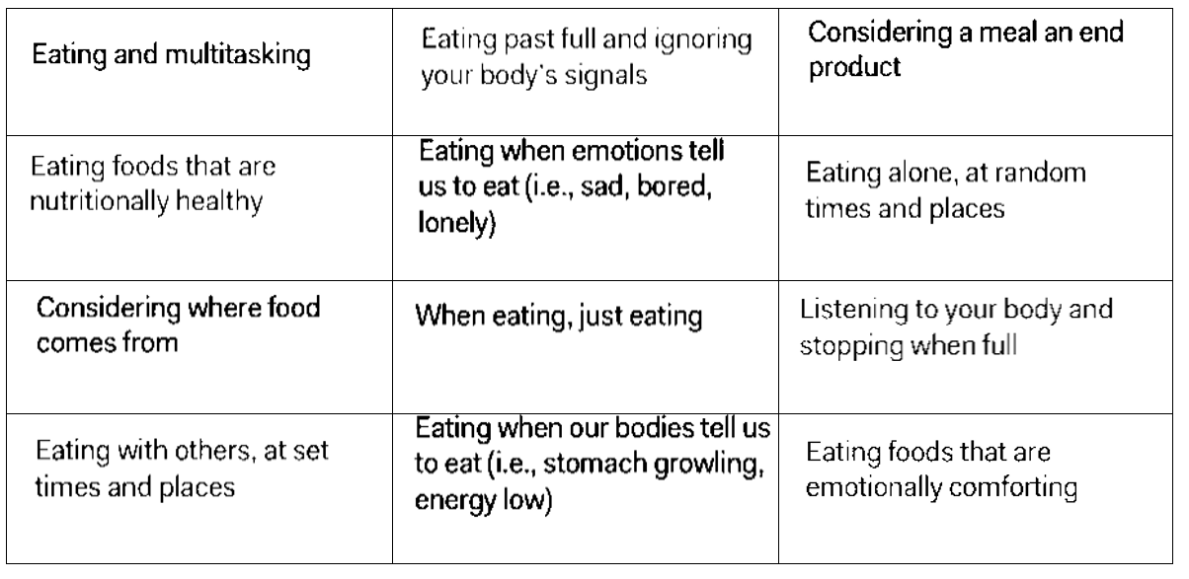
Mindful Eating Pre-Notes Poster Activity
Create a mini poster independently or with a partner
Step 1:
Cut out the statements below (the table)

Slide 18
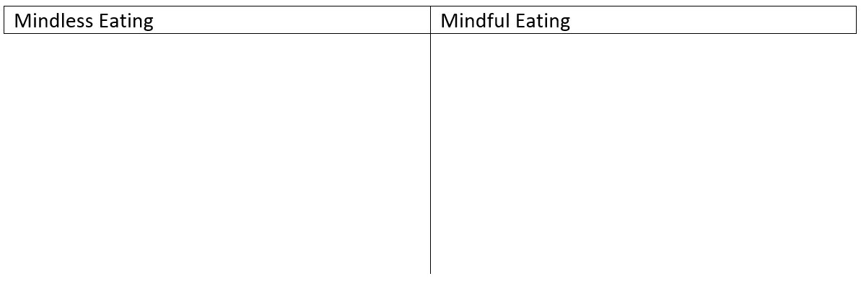
Mindful Eating Pre-Notes Poster Activity
Step 2:
On a new piece of paper write the mindless eating and mindful eating (like shown below)
place the statements from step 1 under the correct heading
once happy with where they belong glue them to the poster
Step 3:
Hand in your completed poster

Slide 19
What is mindfulness?
focusing on being in the present moment—noticing our thoughts, our feelings and our actions without any judgement
With this awareness, over time, your thoughts, feelings and actions can change.

Slide 20
What is Mindful Eating?
Mindful eating is noticing how, what, where, when and why we eat.
Practicing this skill helps us to understand how we feel, and how that can affect the food choices we make.
Mindful eating connects physical, emotional and mental well-being, and increases awareness of the social and environmental factors influencing eating habits.

Slide 21
What is Mindful Eating?
Mindful eating can help us enjoy food more, understand our bodies better, and improve positive feelings about ourselves.
One way to eat mindfully is to pay attention to the experience of eating using our senses.
Even one mindful bite can change our experience of a food or a meal.

Slide 22
When can mindful eating be used?
Breakfast
Lunch
Dinner
Snacks
Any time you eat

Slide 23
What are the senses?
List the 5 main senses of the body
What impact does mindful eating have on our senses?

Slide 24
Senses
Look
Does the food look good?
Listen x 2
The sound the food makes
Taste
Salty, sweet, sour, bitter, savory, etc.
Smell
Provides the first clue to taste
Touch
Texture, moisture, temperature
Does the taste change over time
The sounds your body makes in response to food
Colour, size, texture and shape

Slide 25
Mindful eating at school
Do you use your senses when you are eating at lunch?
Create a list of why or why not (create a list of 5 and hand them in)

Slide 26
Mindful Eating Activity
Each person will be provided with raisin or small food item.
Do not eat the raisin/food item until instructed to.
Wash your hands
Eat 1 of your raisins don’t eat the 2nd raisin until told to do so

Slide 27
Mindful eating activity instructions (slide 1 of 5)
This activity is an example of really being “in the moment” while eating.
I’d like everyone to sit up in your chairs, with your back straight but not too stiff.
Keep your feet planted firmly on the ground.
Notice your breathing.
Let’s take a deep breath together...in...and out....

Slide 28
Mindful eating activity instructions (slide 2 of 5)
Hold the food in your hand. Without talking out loud, answer the following questions in your mind.
What do you notice? What shape is it? What colour is it?
Squeeze the food between your fingers. What sound does it make?
How does it feel in your hand? What is the texture like?

Slide 29
Mindful eating activity instructions (slide 3 of 5)
Please close your eyes.
Hold the food up to your nose and smell it. What do you notice?
If you’d like to, you can put the food in your mouth.
Don’t chew on it yet. Let it sit on your tongue and notice how it feels.

Slide 30
Mindful eating activity instructions (slide 4 of 5)
Slowly start to chew on the food.
What is the flavour?
Is there more than one flavour?
How does it change as you chew it longer?
What is the texture like now?
Chew the food as many times as you can.
Notice how the flavour and texture continue to change.

Slide 31
Mindful eating activity instructions (slide 5 of 5)
If you’d like to, go ahead and swallow the food.
Notice how it feels in your throat when you swallow it.
Now you can open your eyes.

Slide 32
Mindful Eating Activity Questions:
What details did you notice during this activity (that you normally wouldn’t have)?
Review the senses and compare how the first piece was experienced compared to the second (mindful) one.
How did you feel when taking time to slow down and notice the food?

Slide 33
Mindful Eating Activity Debrief
This exercise is very slow, so there is enough time to try practicing each step.
When eating mindfully at a meal or snack, it does not need to take this long.
The goal of mindful eating is to simply notice our senses, thoughts, and overall experience of eating.
Even taking one mindful bite can change the experience of a meal.

Slide 34
Barriers and Solutions to Support Mindful Eating During the School Day
Eating at School
brainstorm influences that affect what we eat and how we eat during the school day

Slide 35
Eating at School
Time
Who I sit with
If I eat alone or in a group
Didn’t bring a lunch
Don't have money for a lunch
I'm on a diet
I'm allergic to everything
My peers will judge me
Even if I have money, I can’t buy anything

Slide 36
How to eat Mindfully
Since the eating environment has an influence on how and what we eat, another way to eat mindfully is to create a calm and positive eating environment.
Eating is an important and essential event that happens everyday, and together we will discuss how to improve our school environment to support mindful eating.

Slide 37
Mindful eating Questions (done in groups of 4). Will be presented to the class.
Here at school, can you describe the eating environment at lunchtime? Where do you eat? Who do you eat with? Is it busy or calm? Do you take time to enjoy your food?
What are at least three reasons we don’t eat mindfully at lunch or when having a snack?
What are at least three ways we can make eating lunch an important event and remind ourselves to eat mindfully at school?
Create a SMART goal to help you eat more mindfully.

Slide 38
Mindful Environment Analysis
Mindful environment analysis
Noting everything in the environment and its impact on you
Not all things can be adjusted to improve the environment (example the fan is rattling too much but it’s attached to the ceiling)
Not just noting your surrounds, but also the impact those surrounds have on your learning
At times students can use inappropriate language to describe things that irritate them in the environment.
Will need to model examples
Example the rattling fan is bleeping me off rather the ratting fan is making it hard for me to focus or hear
Students may not be able to express what in their surroundings is causing issues. This may require one on one time with specific students to help them narrow it down.
If one of the issues is their peers this needs to dealt with tactfully and with little to no disruption to the class

Slide 39
Mindful Environment Analysis Lesson

Slide 40
Mindful Environment Analysis
Noting everything in the environment and its impact on you
This includes objects, like the chairs, the ventilation system, etc.
This can include your peers, but please be discrete.
Not just noting your surrounds, but also the impact those surrounds have on your learning
That fan is rattling too much for me to hear you
That fan is ratting too much for me to concentrate on your instructions

Slide 41
What to do with the analysis data?
A change in seating location for specific individuals
Moving away from things that are distracting
Finding the best things to help you be successful in class

Slide 42
The benefits of mindfulness
More awareness of your life
Reduced stress and a better understanding of yourself and others.
Increases calmness and motivation.

Slide 43
Useful Links and Tips
Guided White Light Meditation Script & Techniques: https://alignedandwell.com/white-light-meditation/
What Is Mindfulness Meditation? https://www.verywellmind.com/mindfulness-meditation-88369
How mindfulness changes the emotional life of our brains | Richard J. Davidson | TEDxSanFrancisco: https://www.youtube.com/watch?v=7CBfCW67xT8
Mindfulness Guided Meditation Scripts for Self Regulation: https://www.teacherspayteachers.com/Product/Mindfulness-Guided-Meditation-Scripts-For-Self-Regulation-2265062

