Slide 1
Naming Compounds

Slide 2
Naming Simple Ionic Compounds

Slide 3
Naming Simple Ionic Compounds
Steps | Examples
 | CaI₂
1. name the metal ion | The metal ion is Ca²⁺ = calcium
2. name the non-metal ion by ending the element name with the suffix IDE | The non-metal ion is I⁻ = iodine Change the ending to get iodide
3. write the name of the compound | calcium iodide

Slide 4
Assignment
Page 187 # 1 (every other letter a, c, e…)

Slide 5
Writing Formulas of Ionic compounds Containing 2 elements
Steps | Examples
 | aluminum fluoride
1. Identify each ion and its charge | aluminum: Al³⁺ fluoride: F⁻
2. Determine the total charges needed to balance positive with negative. | Al³⁺: =+3 F⁻: -1 -1 -1 = -3
3. Note the ratio of positive ions to negative ions. | 1 Al³⁺ ion for every 3 F⁻ ions
4. Use subscripts to write the formula. A “1” is not shown in the subscripts. | AlF₃

Slide 6
Assignment
Page 188 # 1 (all) & 2 (every other letter a, c, e…)

Slide 7
Writing Formulas of Ionic Compounds Containing a Multivalent Metal
Steps | Examples
 | manganese (IV) sulfide
1. Identify each ion and its charge | manganese(IV): Mn⁴⁺ sulfide: S²⁻
2. Determine the total charges needed to balance positive with negative. | Mn⁴⁺: =+4 S²⁻: -2 -2 = -4
3. Note the ratio of positive ions to negative ions. | 1 Mn⁴⁺ ion for every 2 S²⁻ ions
4. Use subscripts to write the formula. A “1” is not shown in the subscripts. | MnS₂

Slide 8
Roman Numerals

Slide 9
Assignment
Page 190 # 1 (all)

Slide 10
Naming Ionic Compounds Containing a Multivalent Metal
Steps | Examples
 | Au₃N
1. Identify the metal | gold (Au)
2. Verify that it can form more than one kind of ion by checking the periodic table | Au⁺ and Au³⁺
3. Determine the ratio of the ions in the formula | Au₃N means 3 gold ions for every 1 nitride ion
4. Note the charge of the negative ion from the periodic table | The Charge on the N³⁻ ion is 3-.
5. The positive and negative charges must balance out. Determine what the charge needs to be on the metal ion to balance the negative ion. | Each of the 3 gold ions must have a charge of 1+ to balance the 1 nitride ion with a charge of 3-. Therefore the name for the gold ion is gold(I).
6. Write the name of the compound | gold (I) nitride

Slide 11
Assignment
Page 191 # 1 (every other letter a, c, e…)

Slide 12
Writing Formulas of a Compound with Polyatomic Ions
Steps | Examples
 | manganese (III) chlorate
1. Identify each ion and its charge | manganese(III): Mn³⁺ chlorate: ClO₃⁻
2. Determine the total charges needed to balance positive with negative. | Mn³⁺: =+3 ClO₃⁻: -1 -1 -1 = -3
3. Note the ratio of positive ions to negative ions. | 1 Mn³⁺ ion for every 3 ClO₃⁻ ions
4. Use brackets around ions to correctly show the ratio of ions. | (Mn)(ClO₃)₃
5. Use subscripts to write the formula. Omit brackets if only one ion is needed. | Mn(ClO₃)₃

Slide 13
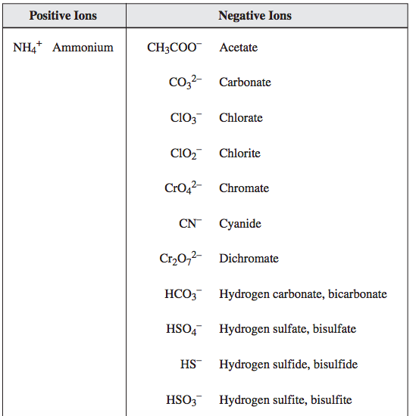

Slide 14
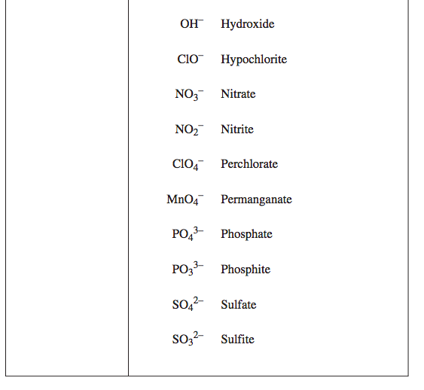

Slide 15
Assignment
Page 193 # 1 (all) & 2 (all)

Slide 16
Writing the Names of Binary Covalent Compounds
Steps | Examples
 | CO
1. name the left most element in the formula first | The first element is C (carbon)
2. name the second element making sure the elements name ends with the suffix IDE | the second element is O (oxygen) it becomes oxide
3. add a prefix to each element name to indicate the number of atoms of each element in the compound exceptions to step number 3 if the first element has only one atom, do not add a prefix the prefix “mono-” is shortened to “mon-” if it is placed before oxide | do not use the prefix when there is only one atom of the first element the compound’s name is carbon monoxide

Slide 17
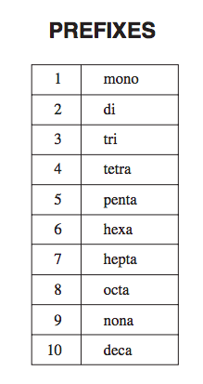

Slide 18
Assignment
Page 195 # 1 (all) & 2 (all)

