Slide 1
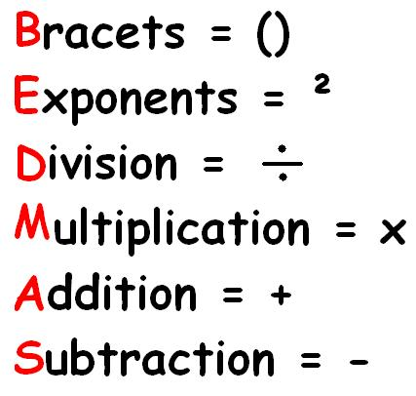
Fraction Operations
If there is a mix of addition, subtraction,
multiplication, and division,
we must follow BEDMAS rules!

Slide 2
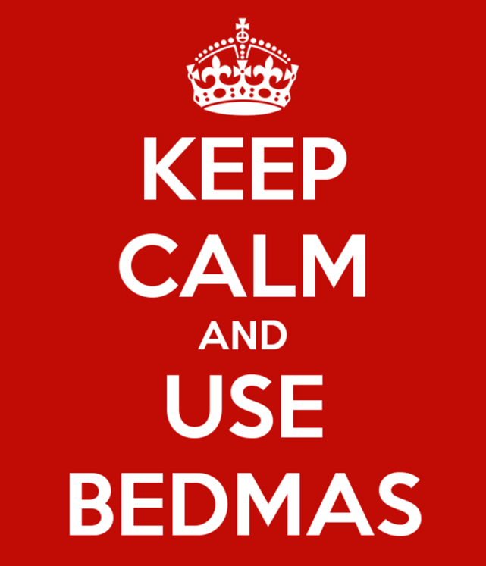
Ex. #1: Calculate each expression.
7 x 1 - 2 ÷ 3 =
2 5

Slide 3
3 ÷ ( 1 + 1 ) ÷ 3 =
2 2 4 4

Slide 4
2 1 - 1 x ( 3 - 1 )
4 2 4 8

Slide 5
Today’s Assignment
Complete
Order of Operations Worksheets 1, 2 & 3 ☺

