Slide 1
Place Value and Writing Numbers
***DO NOT USE A CALCULATOR unless I tell you to

Slide 2
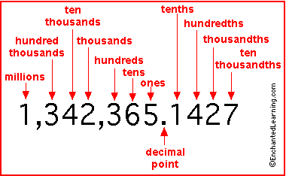
Place Value

Slide 3
Standard form
Standard form is a number written as a numeral:
Example
Four thousand twenty and five tenths
4020.5
Sixteen and forty-four hundredths
16.44

Slide 4
Write the following numbers in standard form
Five hundred twelve and two tenths
Forty thousand twenty five and four thousandths
Five thousand sixty nine and thirty-five hundredths

Slide 5
Write in Words
Converting from Standard form to Words
112.7
0ne hundred twelve and seven tenths
2036.08
two thousand thirty-six and eight hundredths
59.006
Fifty-nine and 6 thousandths

Slide 6
Write the numerals in words
123.5
113.6
12321.5
789867891.123

Slide 7
Rounding
Remember the rules
If the number after the digit you are rounding is 4 or smaller the number stays the same
If the number after the digit you are rounding is 5 to 9 the number is rounded up by one.
14.659 to the nearest tenth
14.7
425.17 to the nearest one
425

Slide 8
Multiplying
When multiplying by factors of 10 it determines which way the decimal goes and how far
If we multiply by 10 the decimal moves one (1) place to the right
If we multiply by 100 the decimal moves two (2) places to the right
For every zero (0) added we move one more decimal place to the right
If we multiply by 0.1 we move the decimal one (1) place to the left
If we multiply by 0.01 we move the decimal two (2) places to the left
For every zero (0) added we move one more decimal place to the left

Slide 9
Multiplication Practice and Assignment
5.68 x 10 = 56.8
2.23 x 10 =
0.036 x 1000 = 36
0.26 x 1000 =
2.73 x 0.01 = 0.0273
3.45 x 0.01 =
4652 x 0.001 = 4.652
54672 x 0.001 =

Slide 10
Dividing
When dividing by factors of 10 it determines which way the decimal goes and how far
If we divide by 10 the decimal moves one (1) place to the left
If we divide by 100 the decimal moves two (2) places to the left
For every zero (0) added we move one more decimal place to the left
If we divide by 0.1 we move the decimal one (1) place to the right
If we divide by 0.01 we move the decimal two (2) places to the right
For every zero (0) added we move one more decimal place to the right

Slide 11
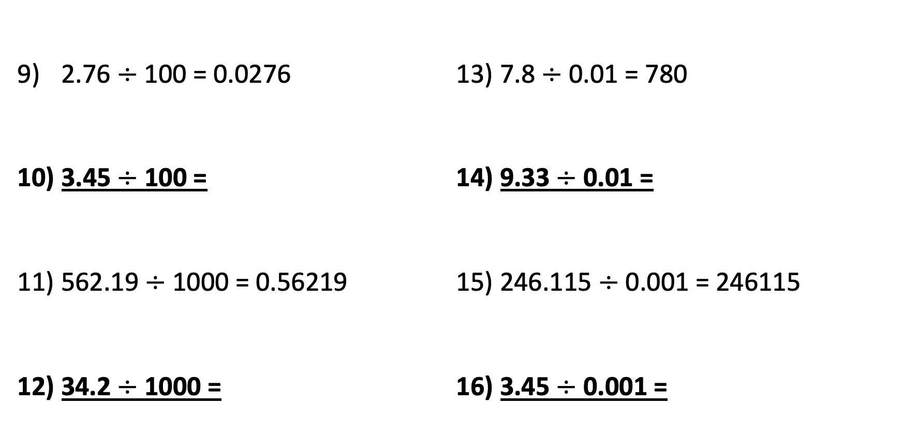
Division Practice and Assignment
2.76 $÷$ 100 = 0.0276
3.45 $÷$ 100 =
562.19 $÷$ 1000 = 0.56219
34.2 $÷$ 1000 =
7.8 $÷$ 0.01 = 780
9.33 $÷$ 0.01 =
246.115 $÷$ 0.001 = 246115
3.45 $÷$ 0.001 =

Slide 12
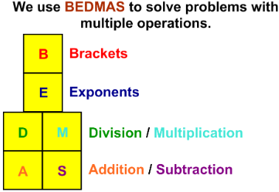
BEDMAS

Slide 13
BEDMAS
Remember to always follow the rules of BEDMAS
Do NOT solve problems using linear math
This is a note for anyone that was taught this method as you will end up with the incorrect answer
How can this go wrong
Correct Format using BEDMAS
4 $÷$ 2 + 6 – 12$÷$ 4 + 3
2 + 6 – 3 + 3
8 – 3 + 3
5 + 3
8
Incorrect Format using Linear Math
4 $÷$ 2 + 6 – 12$÷$ 4 + 3
2 + 6 – 12$÷$ 4 + 3
8 – 12$÷$ 4 + 3
– 4 $÷$ 4 + 3
– 1 + 3
2

Slide 14

Try the examples below using BEDMAS
2 x 3 + 4 =
3 x 5 + 6 =
6 + 5 x 3 =
12 x 2 $÷$ 6 + 4 =
12 $÷$ 3 + 4 x 2 =
(3 + 2) $÷$ 5 + 1 =
3 $÷$ 1 + (3 – 1) =
32 $÷$ (8 x 4) + 3 – 6 =

Slide 15
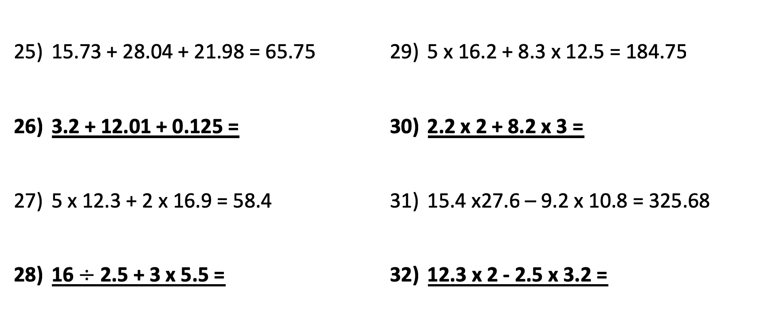
Calculate (may use a calculator for this section)
15.73 + 28.04 + 21.98 = 65.75
3.2 + 12.01 + 0.125 =
5 x 12.3 + 2 x 16.9 = 58.4
16 $÷$ 2.5 + 3 x 5.5 =
5 x 16.2 + 8.3 x 12.5 = 184.75
2.2 x 2 + 8.2 x 3 =
15.4 x27.6 – 9.2 x 10.8 = 325.68
12.3 x 2 - 2.5 x 3.2 =

