Slide 1
A&W Math 11 Section 2.2
Histograms

Slide 2
Histograms
Histograms can be confused with bar graphs but they are not the same
Histograms have no space between the bars as the data is continuous
The bar width represents a specified range of numbers

Slide 3
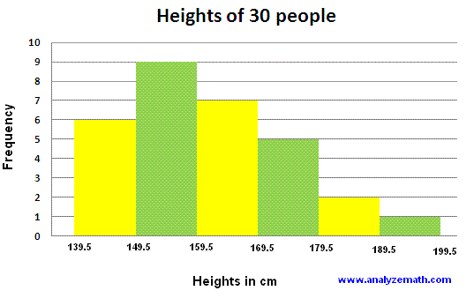
Why is this a histogram not a bar graph? Explain.

