Slide 1
Circle Graphs
Used when considering a part of a whole
Can be turned into a percentage
Each section in the circle represents a specific section of data

Slide 2
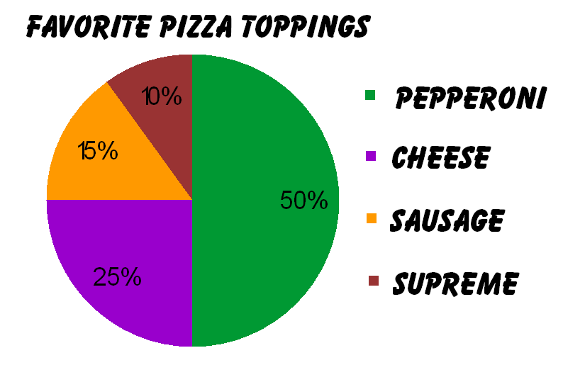
Let us try an Example
400 people were surveyed.
What percentage of people like cheese pizza? How many people is that?
25% = 0.25 x 400 = 100
What percentage of people like pepperoni pizza? How many people is that?
50% = 0.50 x 400 = 200
Which top of pizza is liked the least? Why do you think that is the case?
Supreme is liked the least possibly because of certain toppings. Many people do no like olives.
Notes:
Super Supreme. Pepperoni, Italian Sausage, mild sausage, beef topping, ham, green pepper, mushrooms, red onion, black olives and pizza mozzarella.

