Slide 1
Utilizing Art in Math and Science

Slide 2
Art and Math

Slide 3
Fraction Art
Project Instructions and Criteria
Create a piece of art that uses fractions. Your piece of art can be a drawing, painting, craft, etc. Regardless of the type of art you must be able to count the number of fractions. Show all your work
You can count the fractions by shape or colour.
Need to use a minimum of six shapes or colours.
All fractions need to be simplified, if they cannot be simplified explain why or why not.
Order the fractions from lowest to highest (Duplicates need not be included)
Add all the fractions together to see if they add to a whole (if they do not add to a whole need to check your work)
This is your opportunity to show your understanding of fractions in a unique and artistic way. Be creative and challenge yourself!

Slide 4
Fraction Art Single Point Rubric
Areas that need Improvement | Criteria | Exceeding expectations | Mark
 | Artwork contains six colours or shapes |  | /3
 | Fractions Simplified if possible and justified as to why they can or can't be simplified |  | /3
 | Fractions in the correct order (lowest to highest) |  | /3
 | Fraction addition is done correctly and adds to a whole |  | /3
 |  | Total | /12

Slide 5
Fraction Art
Example:
Simplified Fractions
Blue 3/12 = 1/4 (3/12 can be simplified as both numbers can be divided by 3)
Yellow 2/12 = 1/6 (2/12 can be simplified as both numbers can be divided by 2)
Green 1/12 (this fraction cannot be simplified as it can only be divided by 1)
Orange 4/12 = 1/3 (4/12 can be simplified as both numbers can be divided by 4)
Gray 1/12 (this fraction cannot be simplified as it can only be divided by 1)
Black 1/12 (this fraction cannot be simplified as it can only be divided by 1)
Ordered fractions (Lowest to highest)
1/12, 1/6, 1/4, 1/3
Fraction total
Total = 3/12 + 2/12 + 1/12 + 4/12 + 1/12 + 1/12 = 12/12 = 1 (this means that the addition and counting were done correctly as the answer is a whole)

Slide 6
Decimal/Percentage Art
Using the information from the fraction art students can calculate both decimals and percents for each of the fractions
Fraction to Decimal: dive the top number by the bottom number in the fraction
Decimal to Percent: multiply the decimal by 100

Slide 7
Decimal/Percentage Art Single Point Rubric
Areas that need Improvement | Criteria | Exceeding expectations | Mark
 | Can accurately convert a fraction into a decimal |  | /3
 | Can accurately convert a decimal into a percent |  | /3
 |  | Total | /6

Slide 8
Decimal/Percentage Art Example
Blue 3/12 = 1/4 = 0.25 = 25%
Yellow 2/12 = 1/6 = 0.167 = 16.7%
Green 1/12 = 0.083 = 8.3%
Orange 4/12 = 1/3 = 0.333 = 33.3%
Gray 1/12 = 0.083 = 8.3%
Black 1/12 = 0.083 = 8.3%

Slide 9
Area Art
Project Instructions and Criteria
Create a piece of art that uses area. Your piece of art can be a drawing, painting, craft, etc. Regardless of the type of art you must be able to calculate the area of each section.
You can calculate the area of the shapes and/or colour.
Need to use a minimum of six shapes and/or colours.
Show the formulas used to calculate the area(s).
Need to calculate the total area of your artwork.
Show your work.
This is your opportunity to show your understanding of area in a unique and artistic way. Be creative and challenge yourself!

Slide 10
Area Art Single Point Rubric
Areas that need Improvement | Criteria | Exceeding expectations | Mark
 | Artwork contains six colours or shapes |  | /3
 | The correct area formulas are used in the calculations |  | /3
 | Work is shown for all area calculations |  | /3
 | Total area is calculated, and all steps are shown |  | /3
 |  | Total | /12

Slide 11
Area Art Example
This drawing is made-up of rectangles (A = l x w) and squares (A = s²)
1 red 3 cm x 9 cm rectangle
A = 3 x 9 = 27 cm²
1 green 3 cm x 9 cm rectangle
A = 3 x 9 = 27 cm²
1 orange 3 cm x 6 cm rectangle
A = 3 x 6 = 18 cm²
1 gray 3 cm x 6 cm rectangle
A = 3 x 6 = 18 cm²
1 blue 3 cm square
A = 3² = 3 x 3 = 9 cm²
1 yellow 3 cm square
A = 3² = 3 x 3 = 9 cm²
The total area is
Either adding up the area of all 6 shapes
27 + 27 + 18 + 18 + 9 + 9 = 108 cm²
OR
Calculating the area of the overall shape
A = 12 cm x 9 cm = 108 cm²

Slide 12
Candy Box
Math Topics covered can vary depending on what you want your students to learn
I have done this project 2 different ways
Version 1 is for Surface Area and Volume
Version 2 is for Angles, Scale and Point of View

Slide 13
Candy Box Version 1: Surface Area and Volume (Page 1)
Purpose: to design a candy container that has the most volume for the least amount of surface area (a container that holds the most candies but uses the least amount of material).
Procedure:
Come up with 3 designs of candy containers that you could try
Draw the nets for these so that they take up as much of 1 sheet of paper as possible (remember to include flaps!!)
Cut out the nets and form your containers
Calculate Surface Area (SA) and Volume (V) of each container
Choose the design that has the largest volume and lowest SA as your final design
Make your container catchy so that the public will want to buy your candies

Slide 14
Candy Box Version 1: Surface Area and Volume (Page 2)
Rubric: Candy Container
Category | Description | Points
Structure | When your net is folded, does it form a closed container? Do the sides match up perfectly or are there gaps/overlap? (5 pts)
Design | Is your design neat and eye catching, would people want to buy your candies? (5 pts)
Container | Did you choose a design that had the maximum volume for the least amount of surface area? Can you fit more candies in your final container? (5 pts)
Calculations | Did you accurately calculate SA and V for your 3 designs (5 pts)
Creativity | Did you use any interesting or challenging shapes in your design? (5 pts)

Slide 15
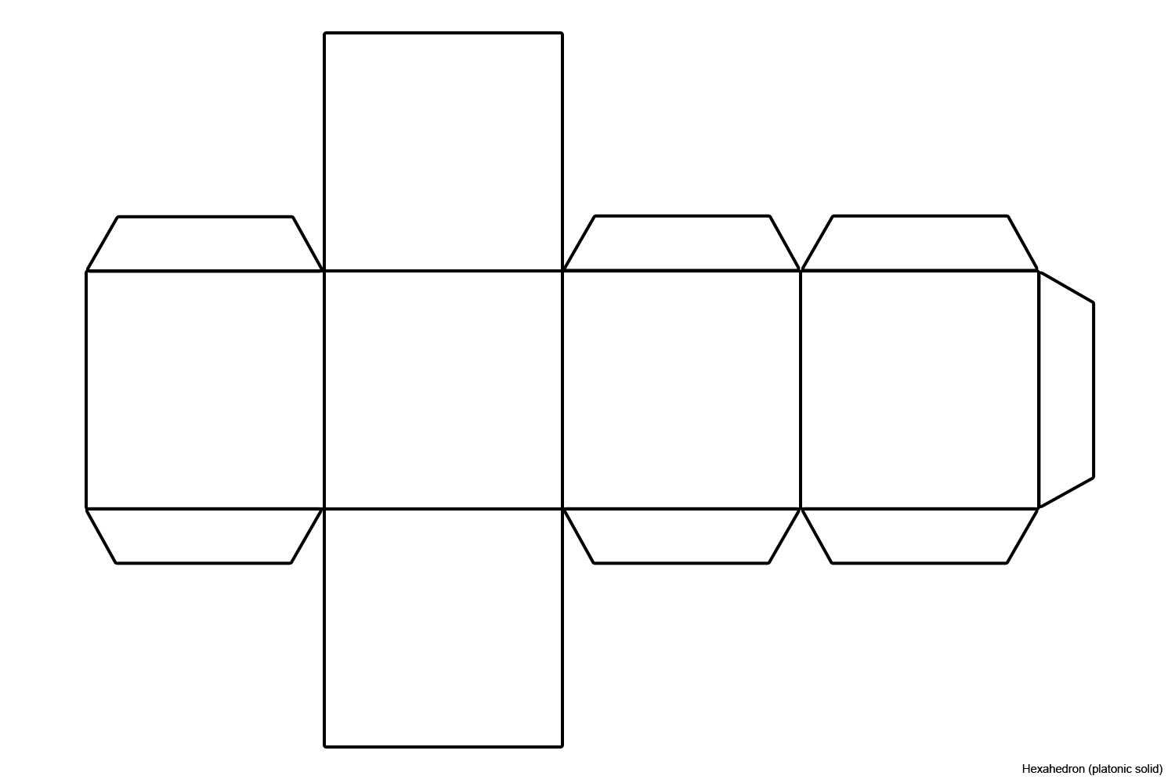
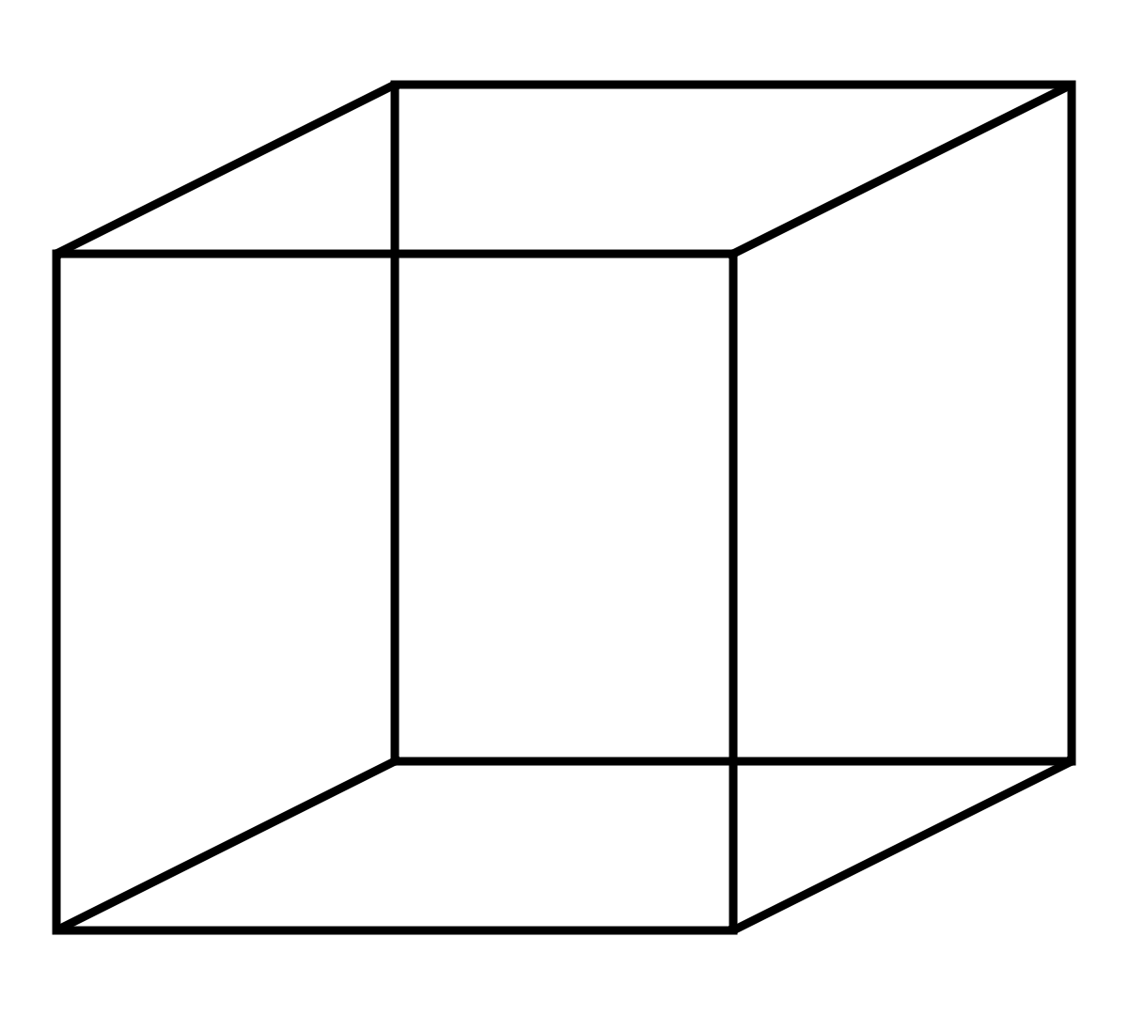
Candy Box Version 1: Surface Area and Volume (Page 3)
Candy Container Example
SA = s² x 6
SA = (4cm)² x 6
SA = 16 cm² x 6
SA = 96 cm²
V = l x w x h
V = s³
V = (4 cm)³
V = 64 cm³
4 cm
fold
As this is a cube all sides are 4 cm long
This Photo by Unknown Author is licensed under CC BY-SA
This Photo by Unknown Author is licensed under CC BY-SA

Slide 16
Candy Box Version 2: Angles, Scale and Point of View (Page 1)
Purpose:
To understand, scale, angles and point-of-view to produce a container that uses the least amount of material but holds the most amount of candy.
Procedure:
Use the nets provided.
Make your container catchy (that is colorful and creative) so that the public will want to buy your candies.
Draw a 1/4, and 1/8 scale diagram of your containers net.
Calculate angles of the sides of each container
Cut out the nets and form your containers.
Draw your container from three points of view (top, bottom and side).

Slide 17
Candy Box Version 2: Angles, Scale and Point of View (Page 2)
Rubric: Candy Container
Category | Description | Points
Structure | When your net is folded, does it form a closed container? Do the sides match up perfectly or are there gaps/overlap? (5 pts)
Design | Is your design neat and eye catching, would people want to buy your candies? (5 pts)
Container | Does your scale diagram match your container (as in the scale is accurate) (5 pts)
Calculations | Angles are measured accurately, and point of view diagrams are correct (5 pts)
Creativity | Did you use any interesting or challenging shapes in your design? (5 pts)

Slide 18
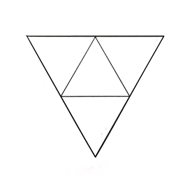
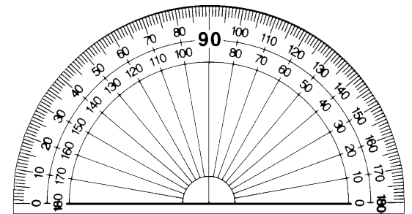
Candy Box Version 2: Angles, Scale and Point of View (Page 3)
Candy Container Example
Original (with protractor to measure angle)
1/4 scale
Angles (this shape is made up of equilateral tringles, so all angles are the same)
60º as can be seen with the protractor over the original
1/8 scale
This Photo by Unknown Author is licensed under CC BY-NC-ND

Slide 19
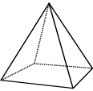
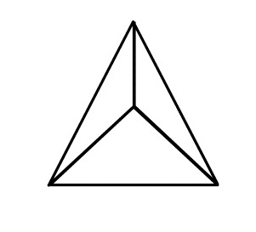
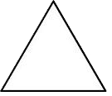
Candy Box Version 2: Angles, Scale and Point of View (Page 4)
Candy Container Example
Assembled box
Point of View
Top View
Bottom View
Side View
This Photo by Unknown Author is licensed under CC BY-SA

Slide 20
Art Project Finances
The goal of this project is to determine the cost of items in order to create an art project
Your job is to include what items are required and how much they cost
You also need to show comparisons of products from different sources
You need to also compare the skill level of the products (is it for a beginner or an advanced skill level)
Examples:
Making a blanket out of yarn
Making a blanked out of fabric
Creating a stuffed animal out of fabric
Witling a bowl out of wood
Witling a ring out of wood
Making a beaded bookmark using a loom

Slide 21
Art Project Finances Single Point Rubric
Areas that need Improvement | Criteria | Exceeding expectations | Mark
 | Artwork contains six colours, shapes or types |  | /3
 | Chose a suitable project with realistic prices |  | /3
 | Clear research was conducted to show the variety of products available |  | /3
 | Total was calculated correctly and justified |  | /3
 |  | Total | /12

Slide 22
Art Project Finances Example (Page 1)
Making a beaded bookmark using a loom
Beading loom (All from Amazon Canada)
Bead Loom Kit for Beginners Weave Necklaces Bracelets Wood Stainless Steel Weaving Beading Set for Jewelry Bracelets DIY Handmade Knitting Machine Beading Tool for $29.69
Beadalon Beading Loom for $8.14
Beadsmith Bead Loom Kit Jewelry Necklace Bracelet Weaving DIY Handmade Knitting Machine Child Educational Toys Great for Beginners for $44.99
I would by the middle of the road one, but it is also important to check ratings.
Beading needles (All from Amazon Canada)
Beadalon 700F-102 Collapsible Eye Needles 2.5-Inch Fine 4 Pack for $8.98
16 Pieces Beading Needles, Seed Beads Needles Beading Embroidery Needles Big Eye Collapsible Beading Needles Set for Jewelry Making with Needle Bottle (5 Sizes) for $12.99
Clover Beading Needles, No. 10-13 for $8.87
I would choose the most expensive one as I have preference as it is super easy to thread and the thread does not fall out.

Slide 23
Art Project Finances Example (Page 2)
Making a beaded bookmark using a loom
Beading thread (All from Amazon Canada)
Beadalon 161U-008 Wildfire .006-Inch Frost, 50-Yard for $13.23
After searching, this one seems to be the best quality of threads as it is non stretch which is extremely important in bead weaving.
Beads (5 to 6 different colours)
16000 Pieces Glass Seed Beads 20 Colors 2 mm Silver Lined Pony Beads Tiny Spacer Beads in Container Box with 18 m Elastic Crystal String Cord for $25.58
BENECREAT 24 Boxes of About 24000 Pcs 11/0 Multicolor Beading Glass Seed Beads 24 Colors Round Pony Bead Mini Spacer Beads Diameter 2mm with Container Box for Jewelry Making $31.99
I would choose the first set as I prefer clear colours not solids

Slide 24
Art Project Finances Example (Page 3)
Making a beaded bookmark using a loom
Calculations
Item | Cost
Beading loom | $29.69
Beading needles | $12.99
Beading thread | $13.23
Beads | $25.58
Total | $78.76
Although this seems rather pricey, it is quite cost effective as the materials will enable me to make at least 2 to 4 bead bookmarks maybe more.

Slide 25
Symmetry Art
Need to draw a picture, paint a background, bead a project, etc.
Project needs to utilize at least 3 different shapes or colours.
Need to determine how many lines of symmetry your project has
Does the project also utilize tessellation? Explain.

Slide 26
Symmetry Art Single Point Rubric
Areas that need Improvement | Criteria | Exceeding expectations | Mark
 | Artwork contains three colours or shapes |  | /3
 | Can accurately determine how many lines of symmetry your art project contains |  | /3
 | Can accurately determine if their project is also a tessellation and explain. |  | /3
 |  | Total | /9

Slide 27
Symmetry Art Examples
One (1) line of symmetry
No lines of symmetry
Neither of these hearts are a tessellation as they are both single images and do not repeat

Slide 28
Symmetry Art Examples
One (1) line of symmetry
Four (4) lines of symmetry
Neither of these squares are a tessellation as they are both single images and do not repeat

Slide 29
Symmetry Art Examples
This piece of artwork has one (1) line of symmetry and is a tessellation as there is a repetition of the shape and no overlapping or gaps.

Slide 30
Art and Science

Slide 31
The Walking Rainbow Rationale
This experiment demonstrates capillary action
It also shows that this action can defy gravity as the water travels up the paper towel
Can also observe colour mixing

Slide 32
The Walking Rainbow Experiment
Hypothesis:
What do you think will happen (read the materials and procedure first)?
Materials:
Seven glasses of equal size
Water (any temperature/kind of water works if it is all from the same source)
Blue, Red and Yellow food coloring
Paper towel

Slide 33
The Walking Rainbow Experiment Continued
Procedure:
Gather all your materials and put on your safety equipment
Fill the 1st, 3rd, 5th, and 7th cup halfway with water.
Add five drops of red food coloring to the 1st and 7th cup.
Add five drops of yellow food coloring to the 3rd cup.
Add five drops of blue food coloring to the 5th cup.
Take 6 strips of paper towel and fold them individually until they are all 1 to 2 inches wide.
Place one end of the paper towel strip into the colored water and the other end into the empty glass.
Repeat step 7 until all 7 glasses are connected by paper towel
Let them sit for at least one hour.
Return to the glasses and observe what happened.
Clean up your supplies and put them away in their appropriate locations.

Slide 34
The Walking Rainbow Experiment Continued
Observations:
Write down what you observed during the experiment.
Write down what you observed at the end of the experiment.
Discussion:
What happens when the colours red and yellow combine?
What happens when the colours yellow and blue combine?
What happens when the colours blue and red combine?
Why do objects appear certain colours? For example why do we see green plants as green?
Conclusion:
Restate your hypothesis. Was your hypothesis correct? Explain why or why not. Write two (2) questions for further experiments that could be done to show capillary action and/or the use of colour.

Slide 35
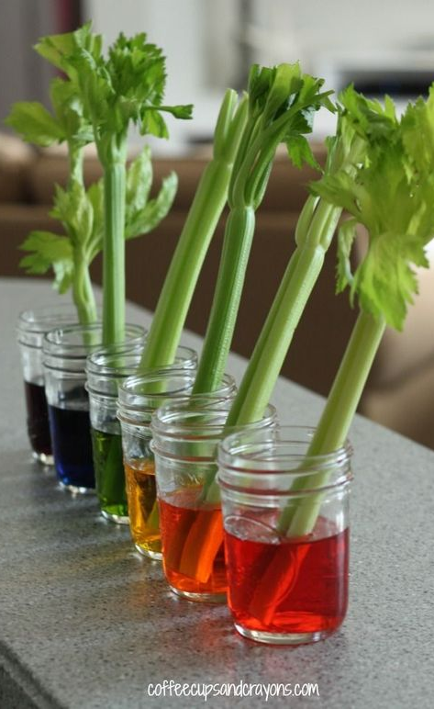
Celery Rainbow Rationale
Shows capillary action
This means that it shows how roots pick up the water and along with it the colour

Slide 36
Celery Rainbow Experiment
Hypothesis:
What do you think will happen (read the materials and procedure first)?
Materials:
Six (6) glasses of equal size
Water (any temperature/kind of water works if it is all from the same source)
Blue, Red and Yellow food coloring
Celery
Knife

Slide 37
Celery Rainbow Experiment
Procedure:
Gather all your materials and put on your safety equipment
Fill all the cups ¾ of the way with water.
In cup 1 place six drops of red food colouring
In cup 2 place six drops of green food colouring
In cup 3 place six drops of yellow food colouring
In cup 4 place six drops of blue food colouring
In cups 5 and 6 create your own colours that are different from the 4 provided (some suggestions are purple, orange, brown, etc.)
Prep the celery by washing the outside and cutting 1 to 2 inches of the bottom to enable the water to enter the celery.
Place 1 stalk of celery in each cup
Leave the cups for 1 hour then observe the celery
You will need to observe your celery the next day as well to see if any additional changes have occurred
Clean up your supplies and put them away in their appropriate locations.

Slide 38
Celery Rainbow Experiment
Observations:
Write down what you observed during the experiment.
Write down what you observed at the end of the experiment.
Discussion:
What colours did the celery turn in each of the six (6) cups?
What colour was the most dramatic and why?
What impact would this have on the plants as they rely on photosynthesis to make their food?
Conclusion:
Restate your hypothesis. Was your hypothesis correct? Explain why or why not. Write two (2) questions for further experiments that could be done to show capillary action and/or the use of colour.

Slide 39
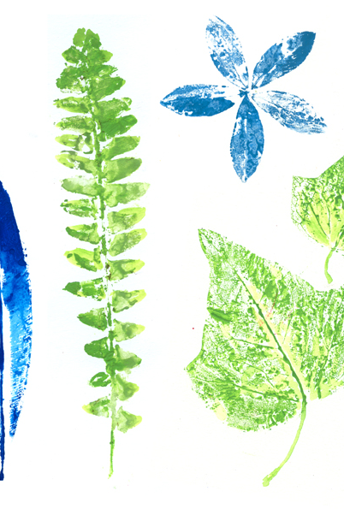
Leaf Print Rationale
Shows the structures of leaves
These prints allow us to see how leaves receive the nutrients they need to flourish
This Photo by Unknown Author is licensed under CC BY-NC

Slide 40
Leaf Print Experiment
Hypothesis:
What do you think will happen (read the materials and procedure first)?
Materials:
Various types of leaves that are still healthy
Water paint, acrylic paint, crayons, ink, etc.
White copy paper
Black or Blue Pen
This Photo by Unknown Author is licensed under CC BY-NC

Slide 41
Leaf Print Experiment
Procedure:
Gather all your materials and put on your safety equipment
Choose a medium (paint, ink, crayons, etc.)
Create a print of at least 4 leaves.
Using the guide provided determine the type of leaves you printed.
Make sure you label your leaves with the following labels: blades, veins and petioles
Clean up your supplies and put them away in their appropriate locations.
This Photo by Unknown Author is licensed under CC BY-NC

Slide 42
Leaf Print Experiment
Observations:
Write down what you observed during the experiment.
Compare your results with other groups that tried different media.
Discussion:
What can you see in your leaf prints?
Did the medium you chose work well? Explain why or why not.
Define blades, veins and petioles. Why are these important for leaves?
How do the structures of these leaves compare to algae? Explain.
Conclusion:
Restate your hypothesis. Was your hypothesis correct? Explain why or why not. Write one (1) question for further experiments that could be done to show leaf structures.
This Photo by Unknown Author is licensed under CC BY-NC

Slide 43
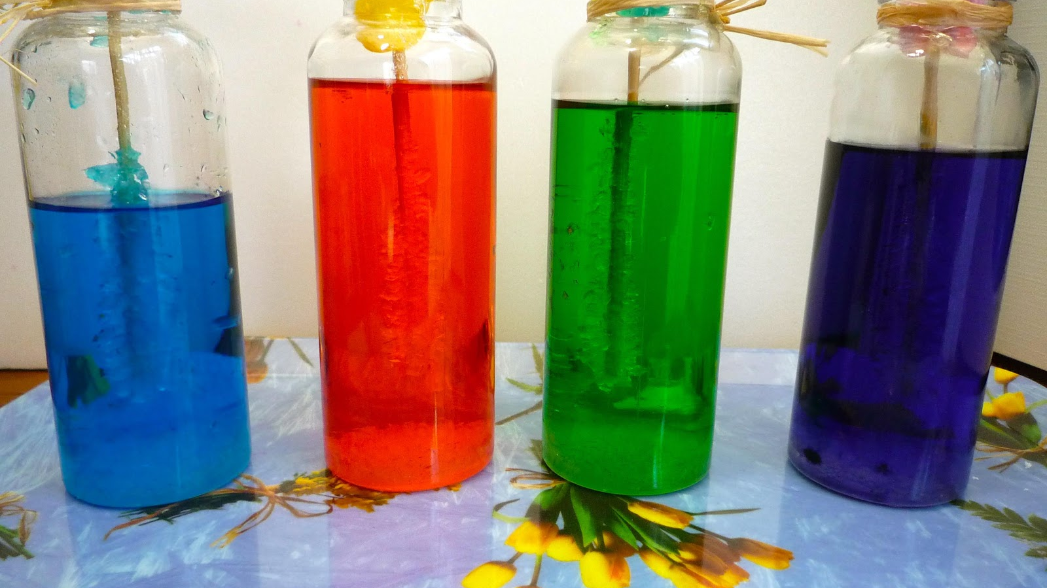
Sugar Crystals Rationale
Shows how minerals, stalactites and stalagmites grow
The crystals grow as the sugar solution is supersaturated meaning the sugar comes out of solution to produce a solid on any surface it can attach to.
Follow this video for best results:
https://www.youtube.com/watch?v=WQdXbf8huuQ

Slide 44
Sugar Crystals Experiment
Hypothesis:
What do you think will happen (read the materials and procedure first)?
Materials:
Sugar
Water
Pipeline or Dowel
Pencil or Clothes Pin
2 jars of the same size
Peppermint oil if desired
Food colouring if desired
Foods room or a place with a stove
1 pot
Measuring cups and spoons
Spoon
Scissors

Slide 45
Sugar Crystals Experiment
Procedure:
Gather all your materials and put on your safety equipment
Mix 1 cup of water with 3 cups of sugar in a saucepan.
Bring to a boil over medium high heat and then remove from heat.
Add food colour or some flavoring (vanilla, peppermint extract, cherry extract etc.) if desired (optional). Stir.
Set up dowel/pipe cleaner
Attach pipe cleaner to the pencil
Make sure it is 1 inch from the bottom of the jar to prevent the crystals growing up the pipe cleaner from the bottom of the jar (this prevents your rock candy from sticking to the bottom of the jar and being impossible to get out, I know I did this the first time)
Pour the syrup you made into a glass container and suspend a pipe cleaner in the solution.

Slide 46
Sugar Crystals Experiment
Procedure Continued:
Cover with paper towel to keep out dust
Store jar in a place where it will not be disturbed
After 24 hours you will see the formation of crystals
Remove crystals that are forming on the edges
Take pipe cleaner our and place on a plate
Transfer syrup into a clean jar and place the pipe clear into the new jar
Steps 11 to 13 must be done again every 24 hours
After a week, the crystals should be large enough
At this point place the crystal suspended in an empty jar to dry out or you can eat it before it dries out if you want
Clean up your supplies and put them away in their appropriate locations.

Slide 47
Sugar Crystals Experiment
Observations:
Write down what you observed during the experiment.
Compare your results with other groups that tried different colours.
Discussion:
How long did it take for crystals appear?
Compare the colour of your solution to the colour of your crystals? Are they the same? Why or why not.
What impact would it have if the crystals were moved to different colored solutions each day?
Conclusion:
Restate your hypothesis. Was your hypothesis correct? Explain why or why not. Write two (2) questions for further experiments that could be done to show the formation of crystals.

Slide 48
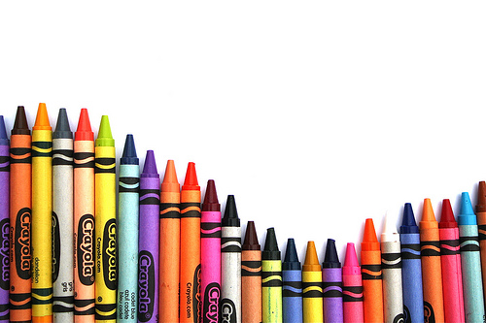
Crayon Rock Cycle Rationale
To observe the effects of pressure and heat on crayons to replicate the transformation between the different rock types
This Photo by Unknown Author is licensed under CC BY-NC

Slide 49
Crayon Rock Cycle Experiment
Hypothesis:
What do you think will happen (read the materials and instructions first)?
Materials:
3 pieces of tin foil that are 6 by 6 inch squares
1 250 mL beaker
Kettle
At least 3 crayons that are different colours
Paper towels
Coin
Water
This Photo by Unknown Author is licensed under CC BY-NC

Slide 50
Crayon Rock Cycle Experiment
Vocabulary:
Igneous rock: formed from the cooling and crystallization of magma and lava
Sedimentary rock: formed when sediments (small pieces of rock) are compacted and cemented together (lithified)
Metamorphic rock: formed when rocks undergo heat and pressure
Weathering: the wearing away or breaking down of rocks by wind, water, sand, and chemicals
Erosion: the movement of sediments produced after weathering, usually by wind, water, and gravity.
Deposition: when sediments are dropped off in a new location after erosion
This Photo by Unknown Author is licensed under CC BY-NC

Slide 51
Crayon Rock Cycle Experiment
Instructions Page 1:
Gather all your materials and put on your safety equipment
Making Sedimentary Rock-Part 1
In nature, rocks are broken down by the forces of nature. In this simulation the crayons represent rocks and the coin represents a weathering agent (wind, sun, ice, rain) that cause rocks to break down into smaller pieces.
Each partner needs to weather their rock. In other words, use a coin to shave your crayons into small pieces. Collect the shavings on a paper towel. Be as neat as you can.
Answer these questions about your weathered rocks:
What do the different colored crayons represent?
What happens to the rock when it is weathered?
Are the fragments all the same size or shape? Describe.
Would you expect all rock fragments in nature to be the same size and shape?
Identify 3 weathering agents (natural ways to weather a rock).
This Photo by Unknown Author is licensed under CC BY-NC

Slide 52
Crayon Rock Cycle Experiment
Instructions Page 2:
Making Sedimentary Rock-Part 1 continued
Once rock fragments have been created, they are usually moved (eroded) by some force of nature like gravity and dropped in a new location (deposition). Here you will act as a depositional force.
Each lab partner, in turn, should move (erode) and lay down (deposit) the rock fragments in a neat pile in the center of the foil. Set each new pile on top of the previous ones.
Answer the following questions:
Describe the shape and size of spaces between your rock (crayon) pieces. Are they large or small and irregular or regular shaped?
What happens to the sediments during erosion?
Identify 3 erosion agents.
What happens to the sediments during deposition?
This part of the simulation requires you to understand the cementation process. Spaces between the fragments are reduced in size by pressure (compaction) and filled in with cementing agents (cementation). This simulation will not add cementing agents. It will only simulate compaction. The compaction process occurs as sediment layers are continually covered by new layers of sediments. The lower layers become compacted by the weight of the new layers above.
This Photo by Unknown Author is licensed under CC BY-NC

Slide 53
Crayon Rock Cycle Experiment
Instructions Page 3:
Making Sedimentary Rock-Part 1 continued
Carefully fold the loose layers of crayon shavings inside the aluminum foil creating a packet.
Press the packet between the palms of your hands and press firmly. You can also place the packet on the table, put your palms of your hands on the top of the packet, and press down. This will compact your weathered and eroded rocks (crayon shavings).
Answer the following questions:
Describe the compaction. Are the sediments tightly or loosely compacted?
Do you see any layers? Are they thin or thick?
Which type of rock is formed after all of these processes (weathering, erosion, deposition, compaction and cementation) have occurred?
Save one small piece of the “sedimentary rock.”
This Photo by Unknown Author is licensed under CC BY-NC

Slide 54
Crayon Rock Cycle Experiment
Instructions Page 4:
Making a Metamorphic Rock-Part 2
As the rocks are pushed deeper into the Earth’s crust, pressure and temperature increases. Metamorphic rock may become contorted in appearance and actually flow like a plastic material in response to the heat and pressure that is caused by the overlying rocks.
Rewrap the loosely compacted, sedimentary rock-type crayons shavings in the aluminum foil.
Fill a beaker with hot (not boiling) water and submerge your packet for 30 to 40 seconds
Pull the packet out and compress for 10 to 15 seconds.
Leave packet to sit for 5 to 10 minutes then look at your rock
Answer the following questions:
Do you see any layers? Describe any layers that you see.
What type of rock is formed by heat and pressure?
In nature, what is causing the increase in temperature and pressure?
Save one small piece of the “metamorphic rock.”
This Photo by Unknown Author is licensed under CC BY-NC

Slide 55
Crayon Rock Cycle Experiment
Instructions Page 5:
Making Igneous Rock - Part 3
Igneous rocks form deep within the earth. They originate in magma chambers embedded in solid rock.
Take your remaining crayon rock in the aluminum foil and place it carefully in your beaker. Make sure your packet has no holes (if in doubt, place in a Ziploc® bag. The cooling process will then form igneous rock.
Allow rock to cool completely before opening the packet
Answer the following questions:
Describe what the melted “rock” (magma) looked like.
Describe the cooling process and the final appearance of the “igneous” rock.
Would your igneous rock be considered an intrusive or extrusive rock? Explain.
Save one small piece of the “igneous rock.”
This Photo by Unknown Author is licensed under CC BY-NC

Slide 56
Crayon Rock Cycle Experiment
Conclusion:
Conclusions-Part IV
Look at all three “rock” samples. Use your simulated “rocks” to help you describe the following rock types.
What is a sedimentary rock?
What processes must occur to produce a sedimentary rock?
What is a metamorphic rock?
What processes must occur to produce a metamorphic rock?
What is an igneous rock?
What processes must occur to produce an igneous rock?
What is the difference between an extrusive and intrusive igneous rock?
Is there evidence of the original rocks (the 3 crayons) in the igneous, metamorphic, and sedimentary rocks that you made? Explain.
This Photo by Unknown Author is licensed under CC BY-NC

Slide 57
Crayon Rock Cycle Experiment
Relationsihpo to art:
What happens when the different colours mix?
What happens when the different colours are melted together?
If one mixes all colours together what colour does one get?
This Photo by Unknown Author is licensed under CC BY-NC

