Slide 1
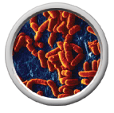
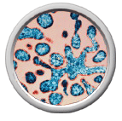
Biology 11 Viruses Notes
Bandali

Slide 2
Viruses are named after the disease
they cause or by what tissue they infect.
Polio

Slide 3
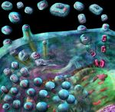
Viruses are composed of nucleic acids
enclosed in a protein coat (capsid)
Smallpox

Slide 4
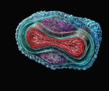
Viruses are considered to be nonliving because:
Don’t carry out respiration
Don’t grow
Don’t develop
Smallpox

Slide 5
They do replicate… however they
require a host cell to carry out
replication.

Slide 6
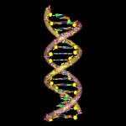
Viral Structure:
Virus is either RNA or DNA

Slide 7
How does a virus infect a cell?
Virus recognizes host cell

Slide 8
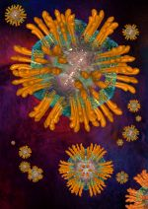
Attachment to a recognized cell.
The virus and cell fit like a key and lock
Hepatitis C

Slide 9
Virus enters cell by injecting nucleic
acid (RNA or DNA) into host cell.
AIDS/HIV

Slide 10
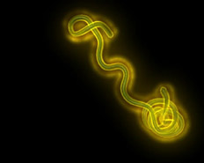
Replication begins by viral nucleic acid
using the host cell’s equipment.
Ebola Virus

Slide 11
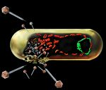
Two Different Cycles of viruses:
Lytic Cycle
Lysogenic cycle

Slide 12
Lytic Cycle
Cell dies quickly
Attachment of virus
Nucleic Acid invades host cell
Replication
Assembly of new virus particles
Cell lyses (ruptures) and virus is released into environment

Slide 13
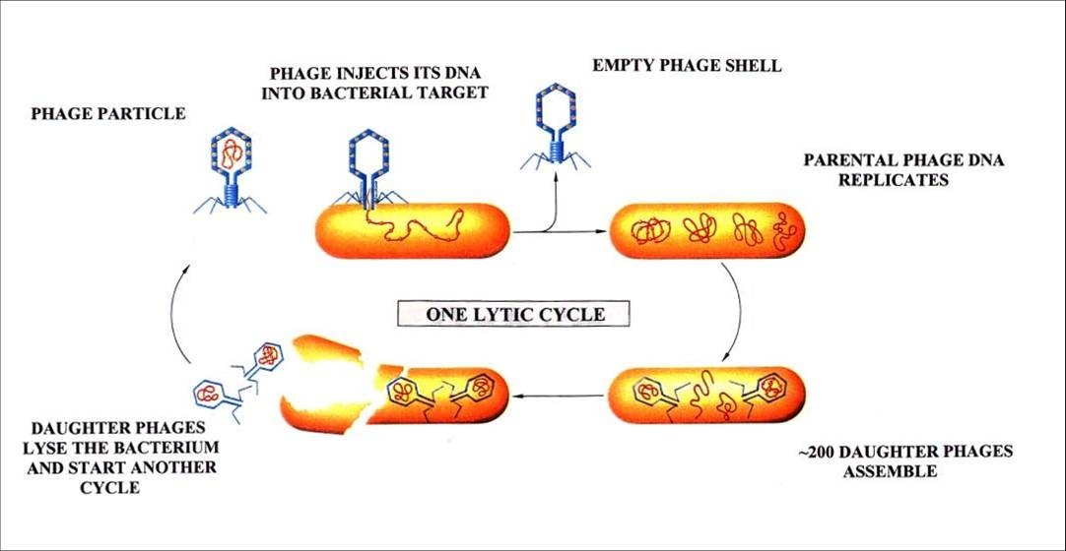
Lytic Cycle

Slide 14
Lysogenic Cycle
Cell does not die quickly
Attachment of virus
Nucleic Acid invades host cell
Virus becomes part of host chromosome –(PROVIRUS)
Cell divides splitting chromosomes and creating new cell with the virus.
Provirus leaves chromosome cont.

Slide 15
6. Viral Nucleic Acid and proteins are assembled
7. Cell lyses (ruptures) and virus is released into environment to infect other cells.

Slide 16
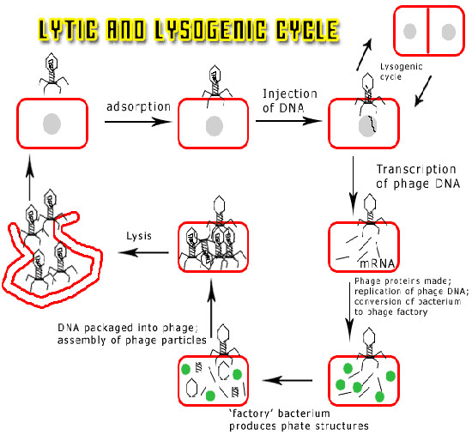
Lysogenic Cycle

Slide 17
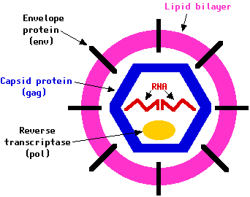

Slide 18
Retroviruses:
RNA viruses
Viral RNA injected into host cell
Host cell’s DNA is used to make viral DNA from viral RNA
Viral RNA uses reverse transcriptase to make viral DNA

Slide 19
4. Viral DNA becomes a provirus
5. Keeps producing new virus without killing cell first

Slide 20
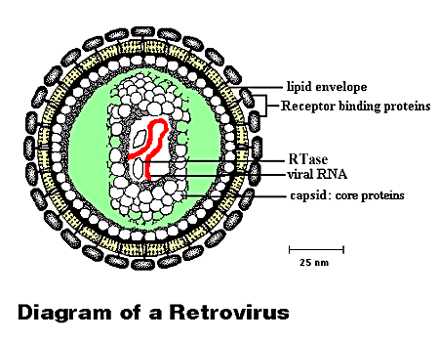

Slide 21
To test for a retrovirus like HIV a blood
test will be done to test for reverse
transcriptase.

Slide 22
Viroids
RNA strand no protein coat
Cause diseases in plants

Slide 23
Prions
Are composed of proteins but have no nucleic acids to carry genetic information.
They act like viruses
Cause diseases such as mad cow disease & Creutzfeldt-Jakob disease.

Slide 24
Tobacco Mosaic Virus
First virus to be identified

